Slide 1
SUPPORTER final conference:
Advancing Gender+ Equality in Widening Higher Education Institutions
Day 2: Advancing Gender Equality Plans in Widening higher education institutions: Challenges, Insights, and Strategies
Prague, 5 June 2025

Slide 2

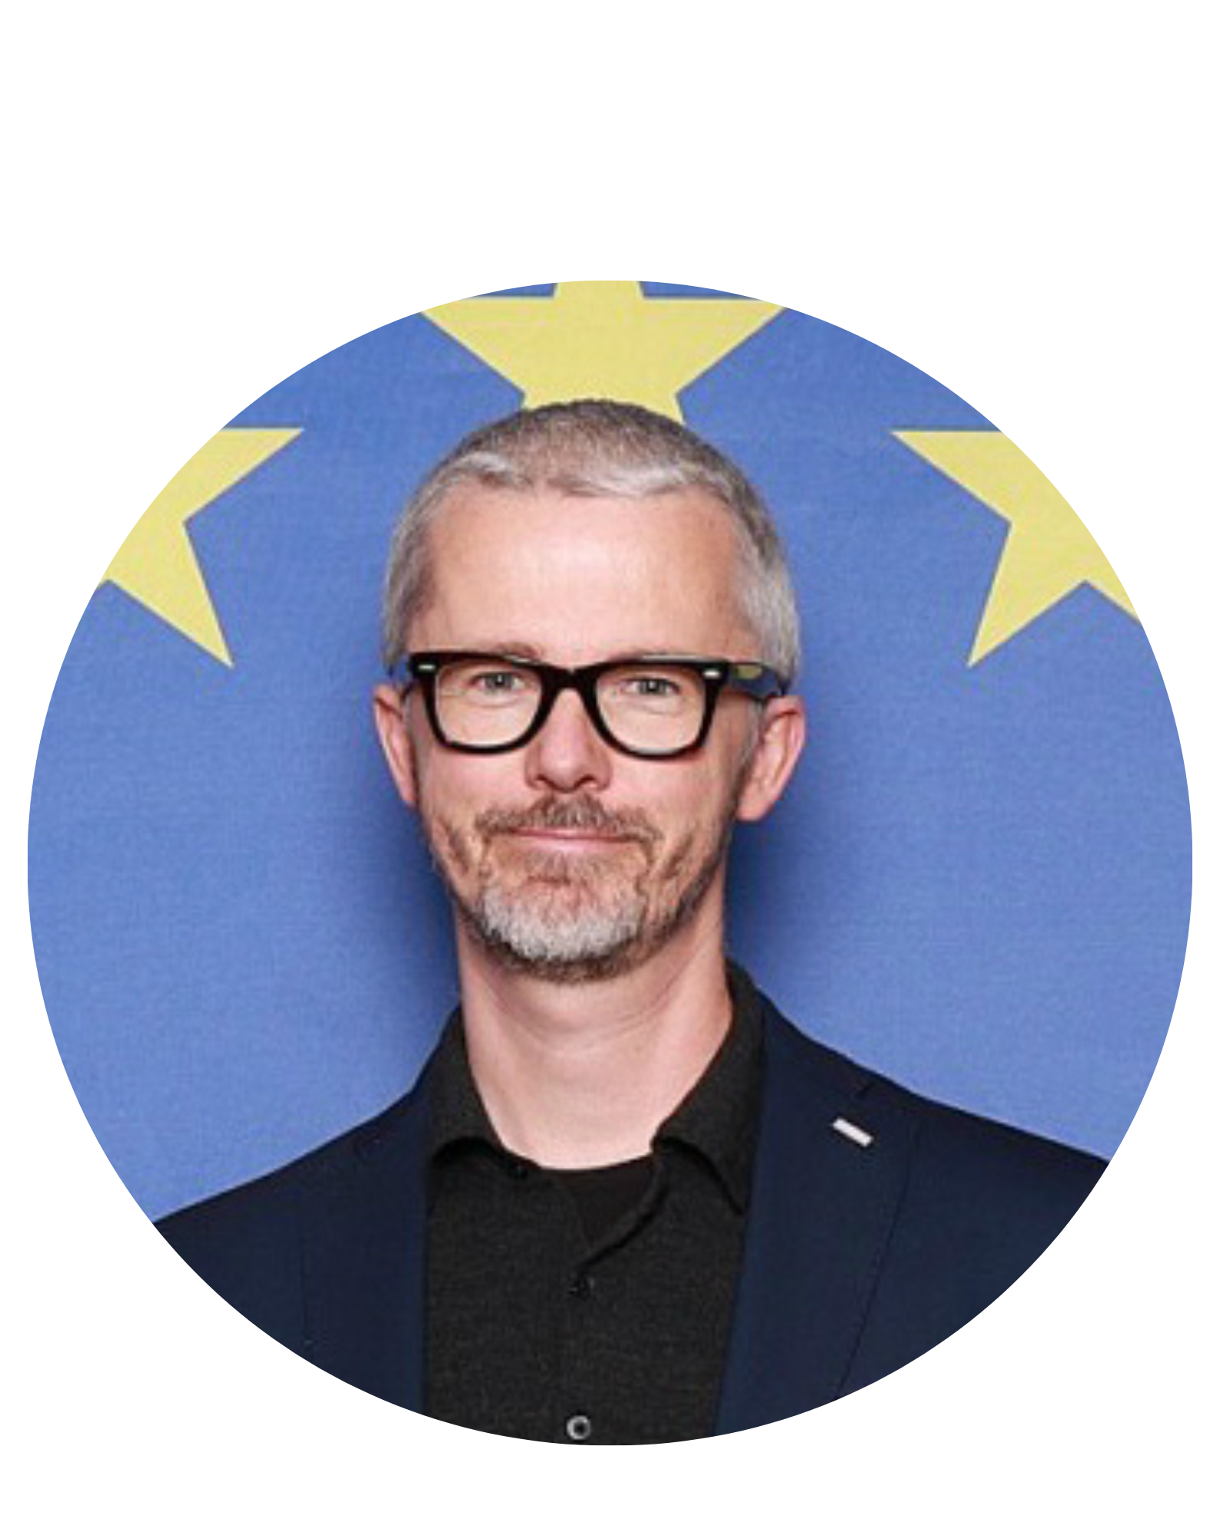
SUPPORTER final conference
Advancing Gender+ Equality in Widening Higher Education Institutions
Welcome addresses
Pavol Kukučka
Head of the Communication Department
at the European Commission
Jade Iafrate
Policy Officer within the Gender team
at the European Commission

Slide 3
SUPPORTER final conference
Advancing Gender+ Equality in Widening Higher Education Institutions
Presentation of SUPPORTER
Sofia Strid, University of Gothenburg

Slide 4
Advancing Gender Equality Plans in Widening Higher Education Institutions
Prague, 5 June 2025
Sofia Strid
Professor of Sociology and Associate Professor of Gender Studies
University of Gothenburg

Slide 5



Sport higher education institutions are not immune to the
power structures and inequalities that shape the wider world
Uniquely positioned to promote fairness, health and well-being
Highly valued for empowering youth, promoting inclusivity and team spirit
Microcosm of sexual harassment and assault, idealising toxic masculinities
Inherent culture of violence
Funded by the European Union.
Notes:
Sport environments uniquely positioned to promote fairness, health and well-being
Highly are valued for empowering youth, promoting inclusivity and team spirit
Yet they are also infamously known as a microcosm of sexual harassment and assault, idealising toxic masculinities, and for their inherent culture of violence.
Studies also highlight sports institutions incapacity to protect potential victims and to provide equitable conditions to inequality groups based on age, disability, gender, gender-identity, ethnicity, nationality, race and sexual orientation, as well as those at the intersection of these inequalities.

Slide 6
Sport higher education institutions
Not immune to the power structures and inequalities that shape the wider world
Not neutral
Exist in relation to the power dynamics and inequalities that shape our wider society
Reproduce and reinforce those structures, consciously or not
Includes the normalisation of inequalities and violence
We must dare to recognise this in order to change it.

Slide 7

SUPPORTER response:
Strategic initiatives for institutional change
Formulate and implement tailored intersectional, innovative, inclusive and impactful Gender Equality Plans in the eight partner sports higher education institutions explicitly addressing gender-based violence
Innovative training programme ​
Mentoring and expert support​
Co-creation approach​
Mutual learning environment​

Slide 8


SUPPORTER
Aim: to support sports higher education institutions to develop intersectional, innovative, inclusive and impactful Gender Equality Plans, explicitly addressing gender-based violence and sexual harassment.
Duration: April 2023 - September 2025, coordinated by the European Science Foundation
8Gender Equality Plans for Sports Education Institutions that also address gender based-violence
Gender+ equality and gender based-violence policies and practices in the field of sport education
Mutual learning:
development of training and mentoring-monitoring scheme

Slide 9
SUPPORTER achievements
Documented systemic challenges faced by sports higher education institutions in advancing gender equality and eradicating gender-based violence.
Developed activities adapted to the context and tailored to each partner institution.
Strengthened sports institutions’ organisational capacity to address gender equality with an intersectional approach.
Fostered an inclusive institutional culture by developing mutual-learning processes.
Strengthened networking and exchange among sports institutions and with communities of practice.
Fostered gender related institutional, sustainable, transformative change in the sports institutions with a specific attention to gender-based violence.

Slide 10

Sport has power: Let's use it for good
Contribute to the transformation of institutions to advance inclusive gender+ equality within the European Research Area.
Sport has the power to transform lives.
Create sport higher education institutions that not only excel in academic and athletic performance but also lead the way in equality, dignity, and human rights.

Slide 11


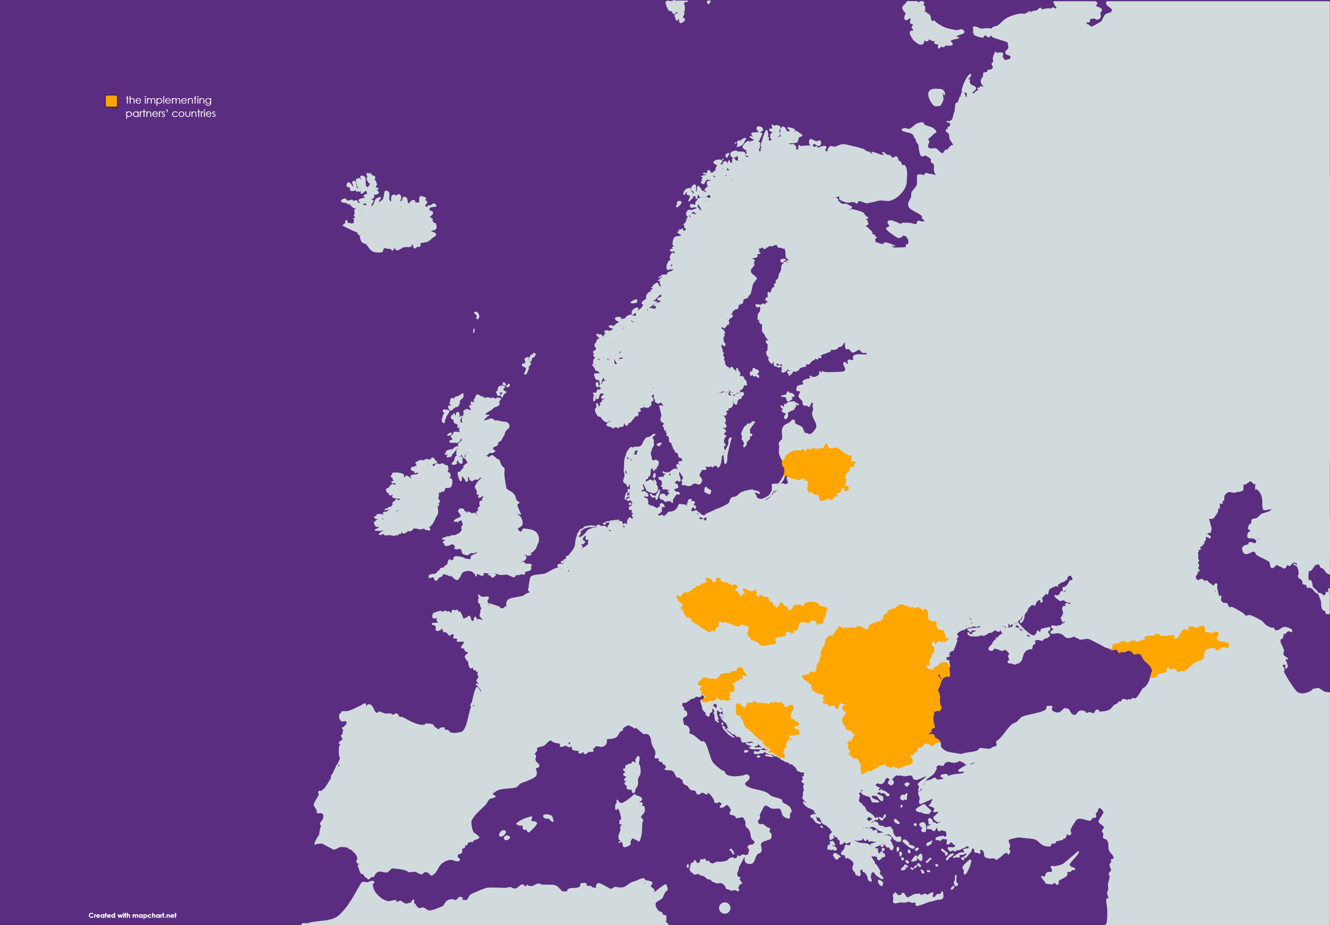
Supporting the design and implementation 4I-GEPs in eight sports institutions:
Univerzitet u Banjoj Luci (Bosnia & Herzegovina)
Univerza v Lubljani (Slovenia)
Univerzita Karlova (Czechia)
Национална Спортна Академия "Васил Левски"(Bulgaria)
Lietuvos Sporto Universitetas (Lithuania)
Universitatea de Vest din Timisoara (Romania)
სპორტის უნივერსიტეტი (Georgia)
Universitatea de Stat de Educație Fizică și Sport (Moldova)

Slide 12
SUPPORTER final conference
Advancing Gender+ Equality in Widening Higher Education Institutions
Panel 1: Tailoring GEPs in higher education institutions
to specific ecosystems

Slide 13
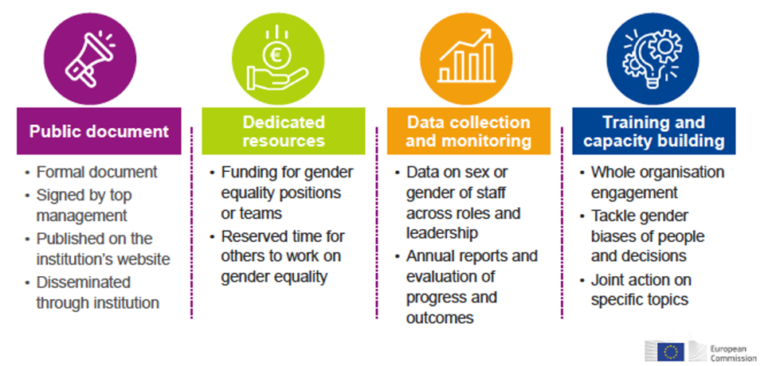
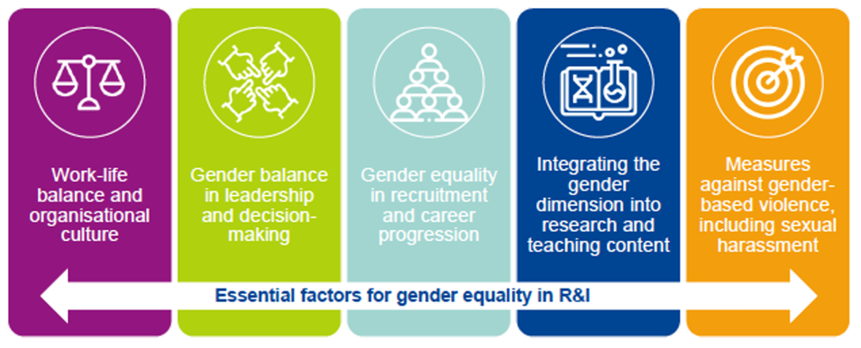
Horizon Europe, Gender Equality Plans. Eligibility criterion
Mandatory elements
Recommended fields of action
Source – European Commission, DG Research and Innovation

Slide 14
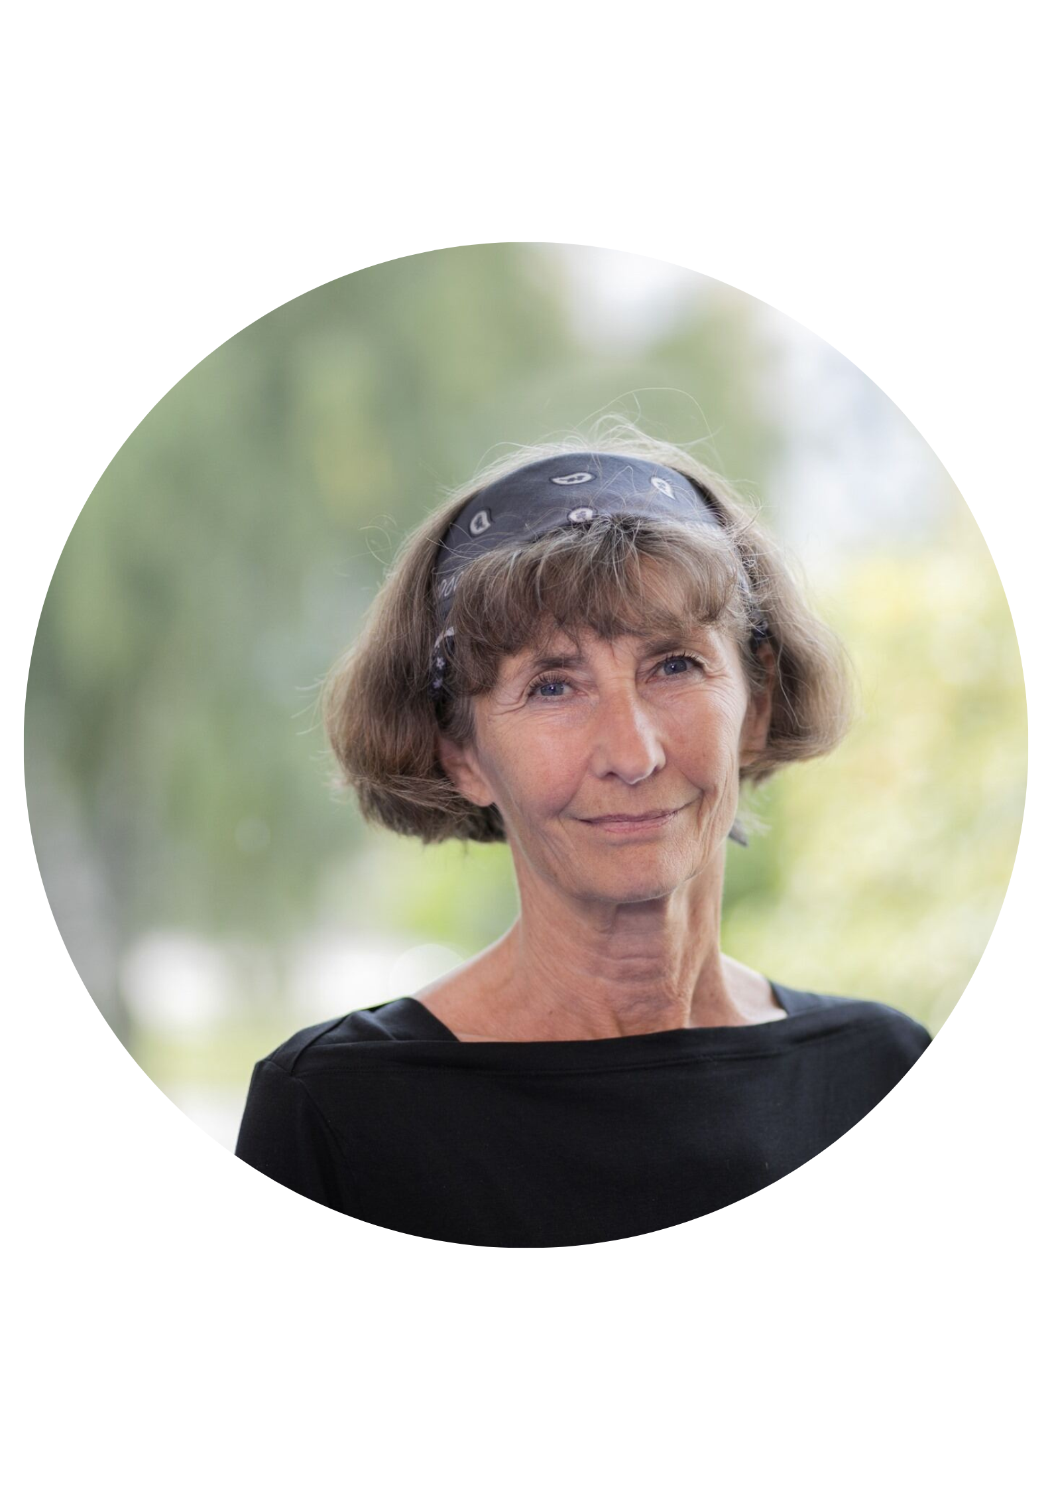
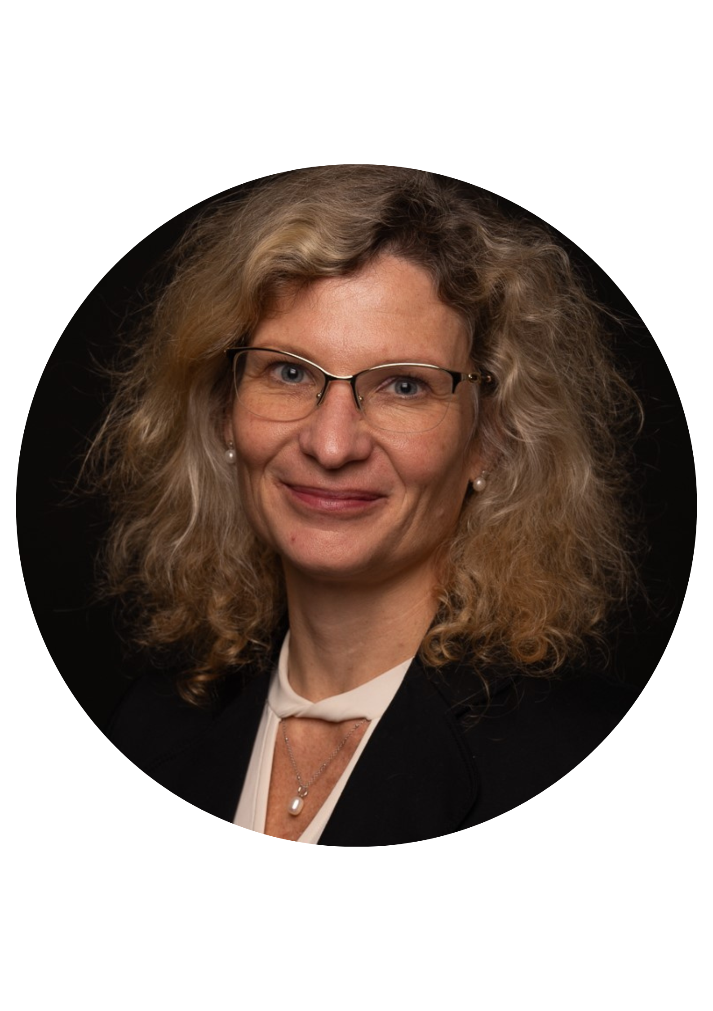
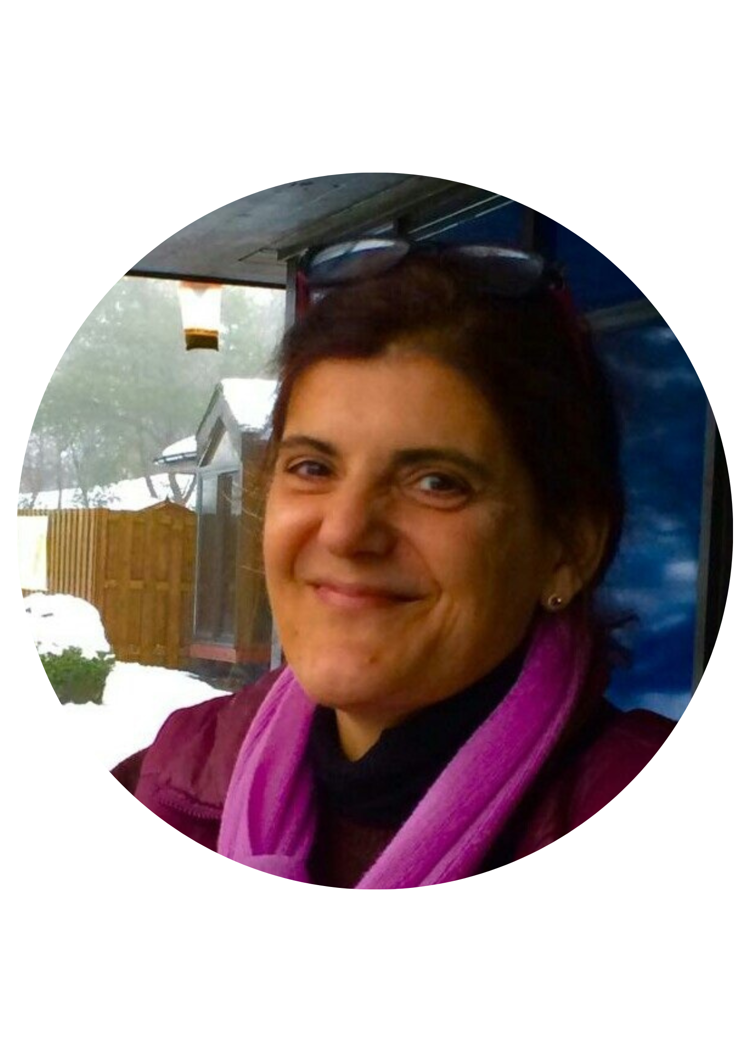
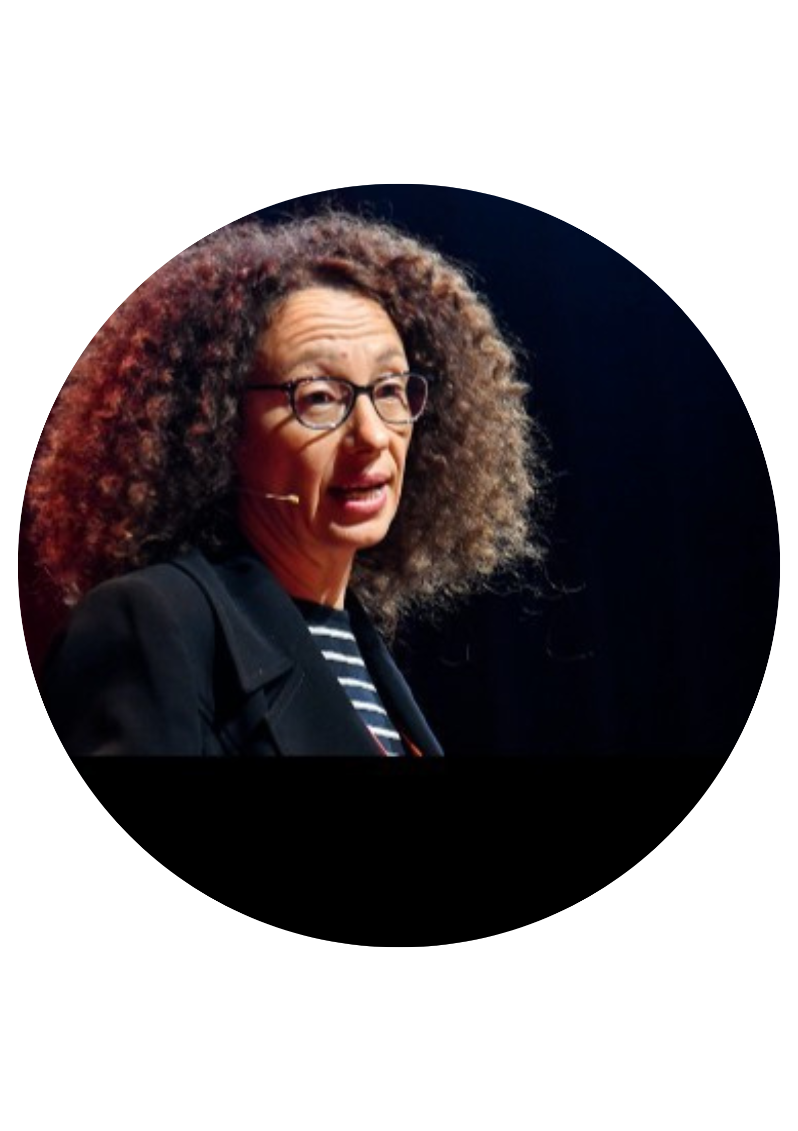




SUPPORTER final conference
Advancing Gender+ Equality in Widening Higher Education Institutions
Panel: Tailoring GEPs in higher education institutions to specific ecosystems
Suzanne Lundvall
professor of sports science
at Gothenburg University
Jana Mazancová
researcher at the Czech University of Agriculture in Prague
Sara Clavero
researcher at TU Dublin and deputy director of RINCE
Maria Sangiuliano
research director
at Smart Venice

Slide 15

Lunch Break

Slide 16
SUPPORTER final conference
Advancing Gender+ Equality in Widening Higher Education Institutions
Panel 2: (In)visible change agents and their role
in promoting gender equality

Slide 17
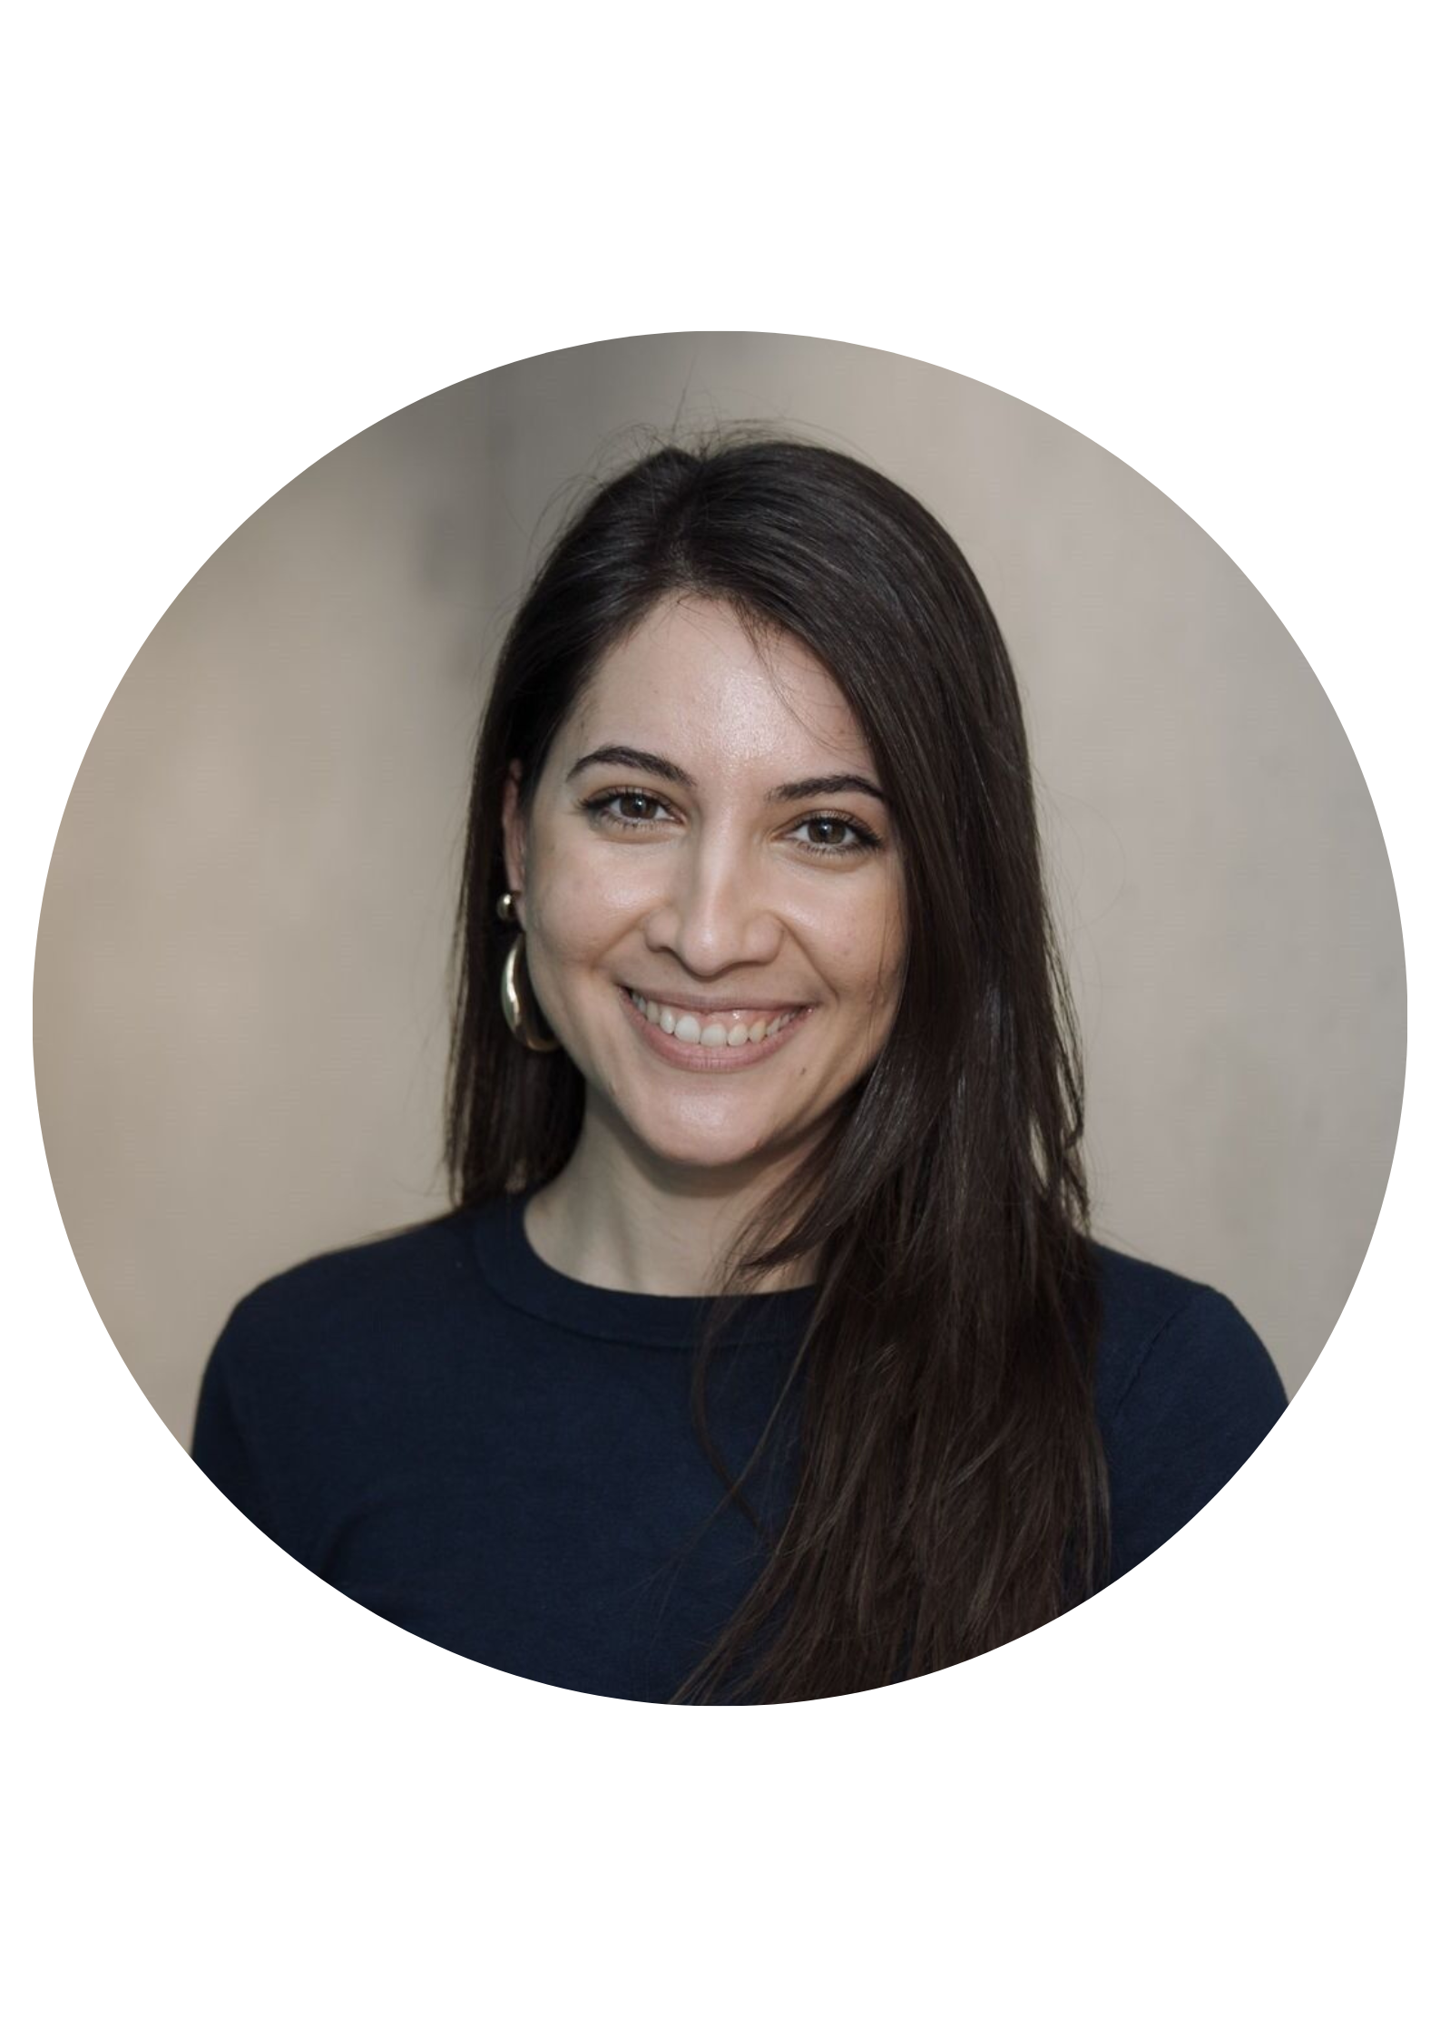
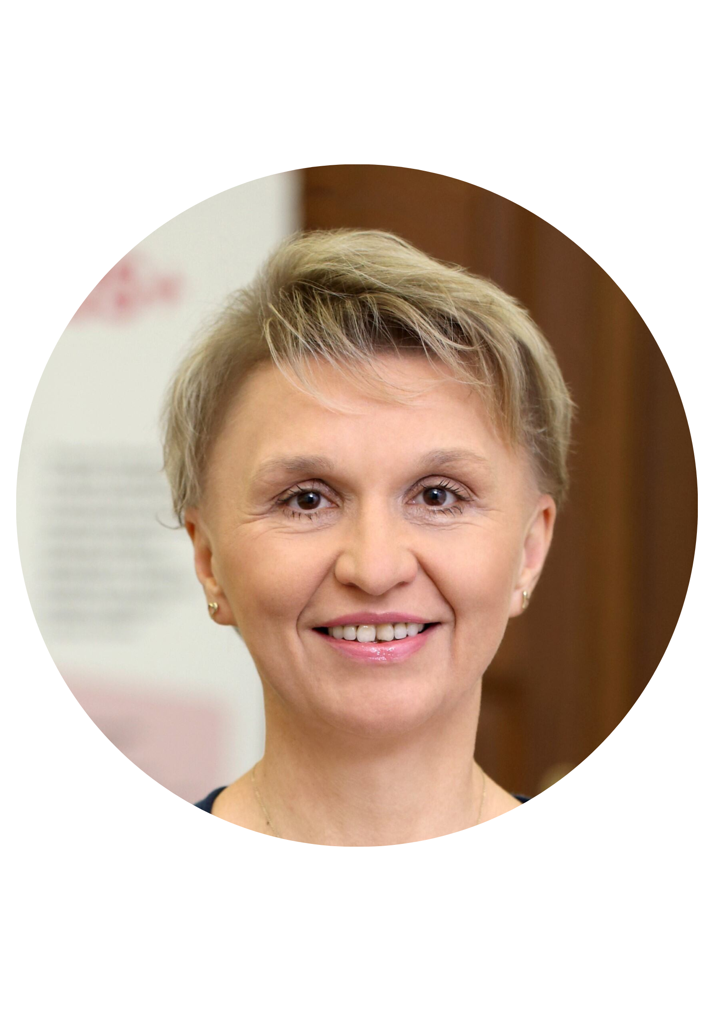
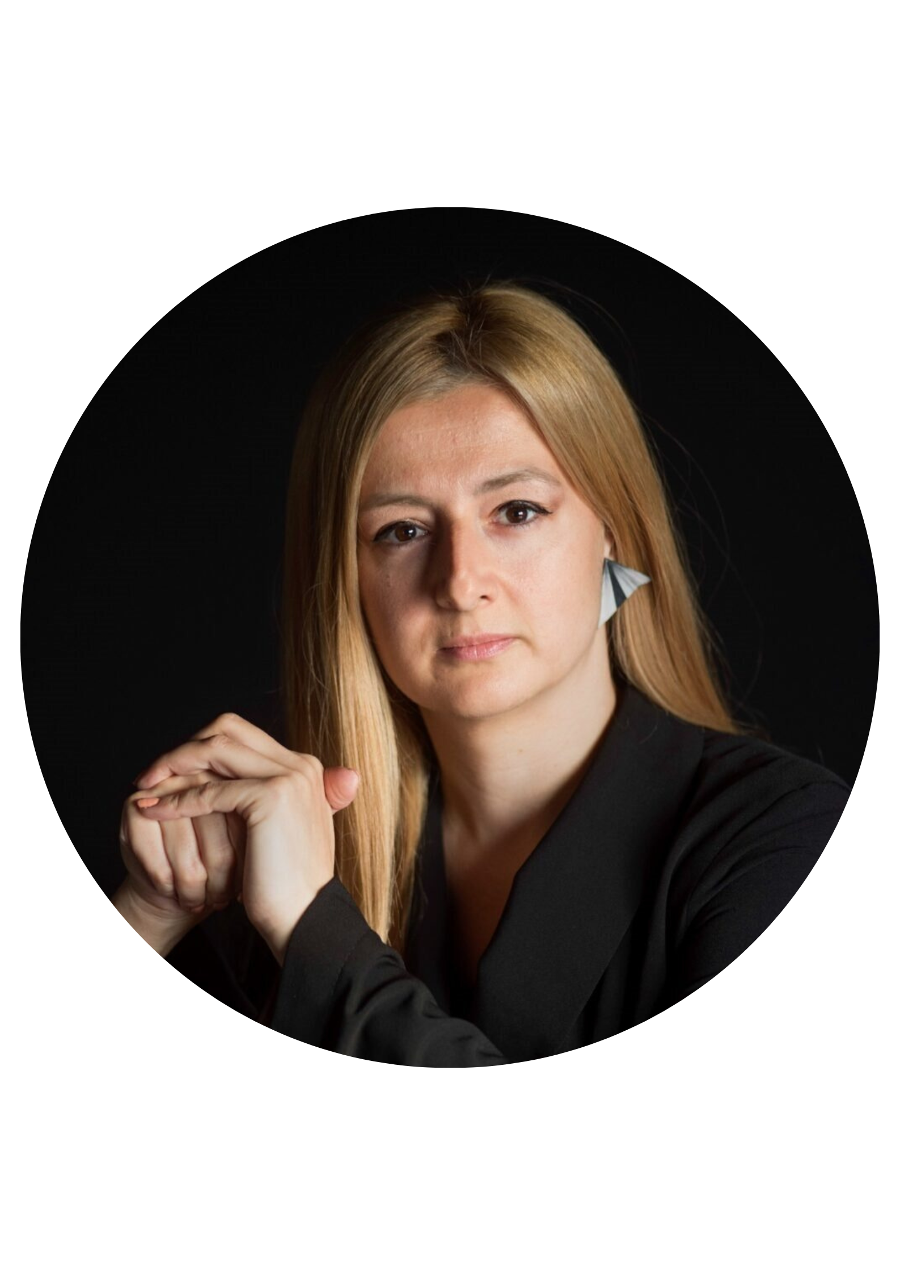
SUPPORTER final conference
Advancing Gender+ Equality in Widening Higher Education Institutions
Panel 2: (In)visible change agents and their role in promoting gender equality
Jelena Ćeriman
research fellow at the
University of Belgrade
Lenka Henebergova
member of the Rector's Board for Social Affairs and Sustainable Development
Panagiota Polykarpou
consultant for equality, diversity and inclusion at Yellow Window

Slide 18

Coffee Break

Slide 19
SUPPORTER final conference
Advancing Gender+ Equality in Widening Higher Education Institutions
Panel 3: Sustainability: Achieving gender equality
in the long run

Slide 20
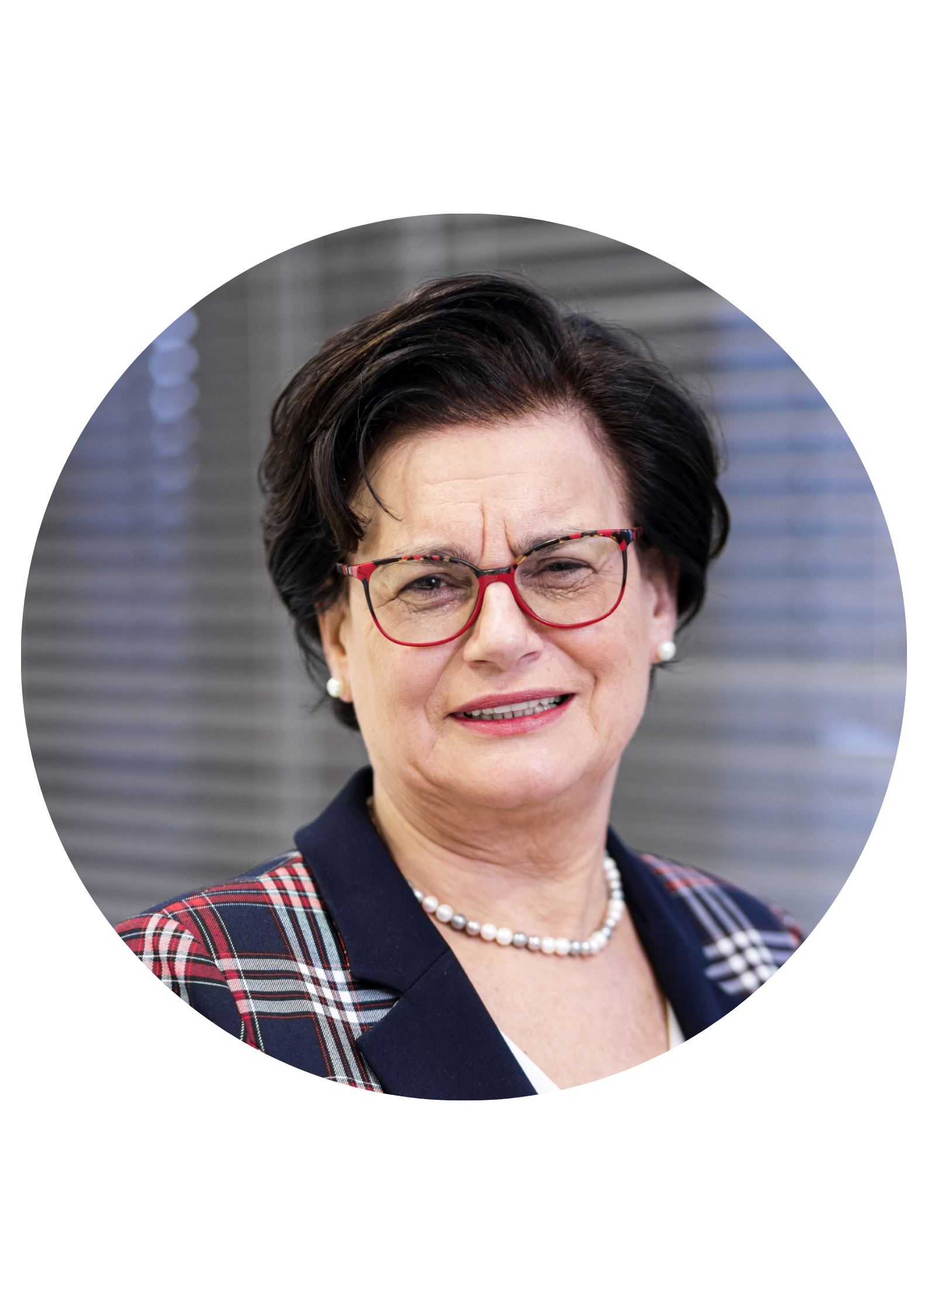
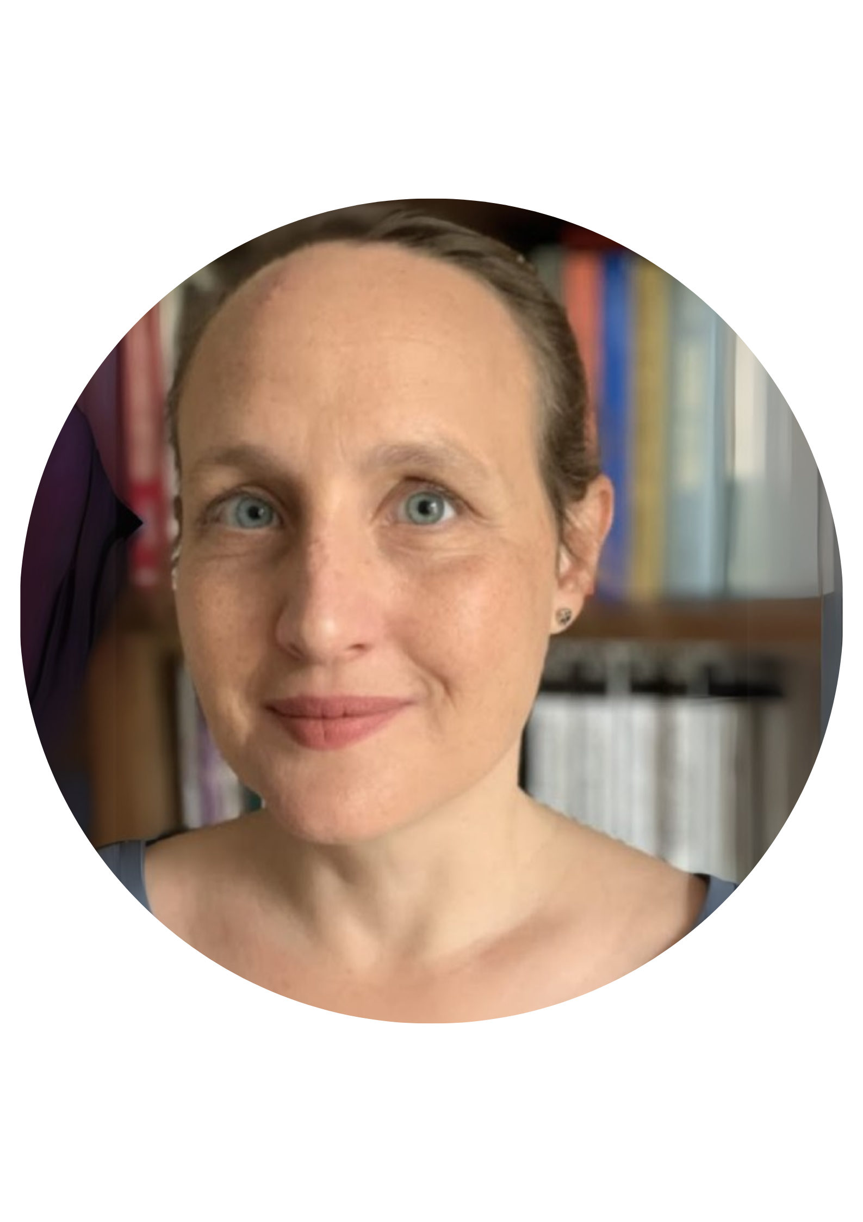
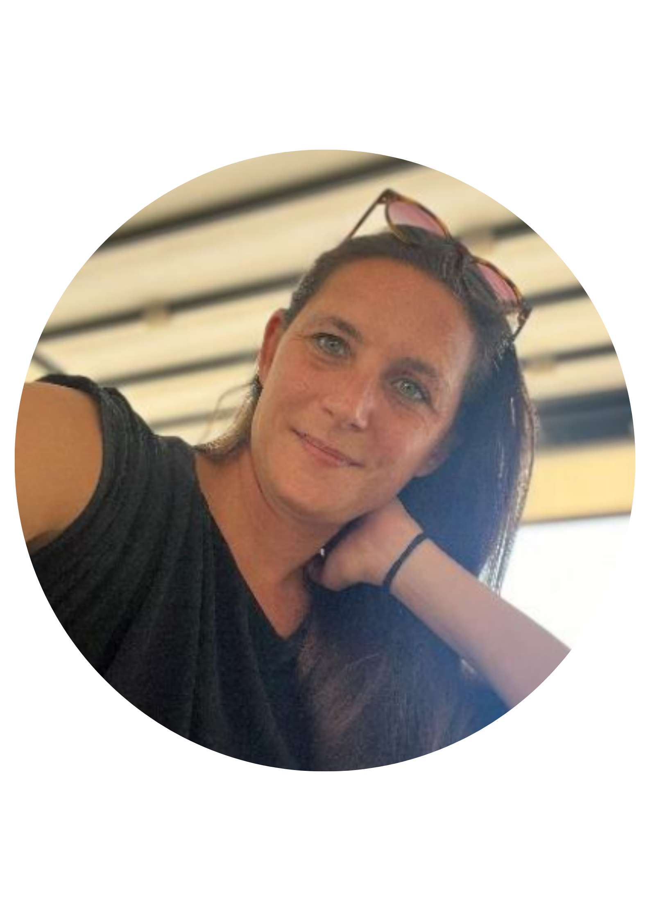
SUPPORTER final conference
Advancing Gender+ Equality in Widening Higher Education Institutions
Panel 3: Sustainability: Achieving gender equality in the long run
Gabriela Langhammerová
gender expert and lecturer at the Czech Academy of Science
Ewa Łojkowska
professor at the University
of Gdańsk
Katjusa Radinović
head of the research office at Ljubljana University

Slide 21



Gender equality in academia as an achievable and sustainable matter
SUPPORTER final conference
Prague, Charles University
Gabriela Langhammerová, PhD.
05. 06. 2025

Slide 22


Gender equality and institutional change
From „fixing women“ to „fixing institutions“ and „fixing knowledge“
  gender equality plan (GEP) is a pivotal tool
Three intertwined levels of change
  Institutional (measures, policies, responsibilities, decision-making processes)
  Cultural (support of the management, internal and external communication, representations)
  Personal (expertise, attitudes, biases)
Symbolic function (=cultural level) squeezes into processes and practices (=institutional level), which are then acted upon by specific people (=personal level). This leads to an influence on the overall functioning of the institution (=institutional change)

Slide 23

Monitoring and evaluation strategies
Intervention logic
Analysis
Context factors reflection
Setting the objectives
Definition of specific steps and activities

Slide 24

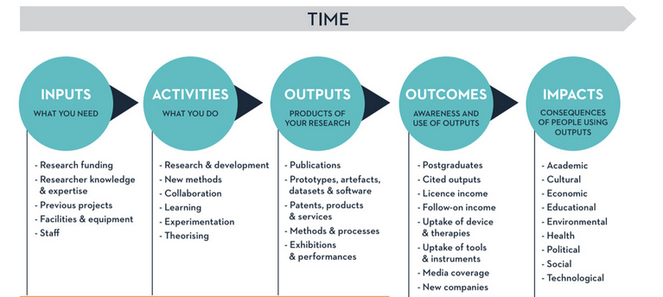
Monitoring and evaluation strategies
Impact pathway

Slide 25

Sustainability of GEP actions: Indicators
Thematic area: Gender balance in leadership and decision-making – example of indicator setting
Cultural level
  Introduce proactive measures to identify suitable female candidates through active outreach and direct support to potential female candidates (indicator: number of identified female professionals suitable for the positions).
Institutional level
  Ensure an increase in the proportion of women in the pool for selection for leadership positions by explicitly stating that women are welcome (indicator: calls for prospective employees).
  Increase progressively the proportion of women in leadership positions (in specific committees/commissions.) by setting percentage targets for women's representation (indicator: indicating the target percentage of women in the specified positions in the relevant regulations or internal guidelines).
  Ensure that information on regulations, procedures and processes relating to career advancement is widely known, disseminated and accessible to all (Indicator: inclusion of detailed information in the information package on entry, regular briefing by management at worker meetings).
Personal level
  Increase women's motivation to participate in tenders through networking with women in senior positions and informal sharing (indicator: number of networking/sharing events,participant satisfaction).
  Organise leadership training for women (indicator: training delivered, content, number of participants and age).

Slide 26

Monitoring and evaluation strategies for GEP sustainability:
Change agents
Key factor for GEP sustainability
Sufficient support
Cooperation within and outside intitution
„Care for carers“
Capacity building

Slide 27

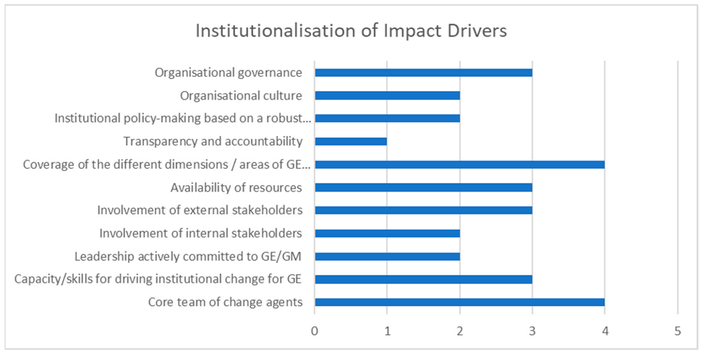
Sustainability of GEP actions – Impact drivers

Slide 28
Sustainability of GEP actions
Intervention logic – impact pathway - indicators
Impact drivers – tool for measuring institutional change
Working all levels of change at once
Support of change agents
SMART rule for indicators
Mutual cooperation between departments within institution

Slide 29
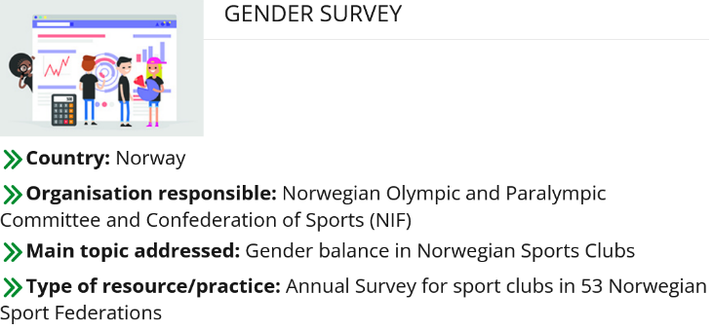
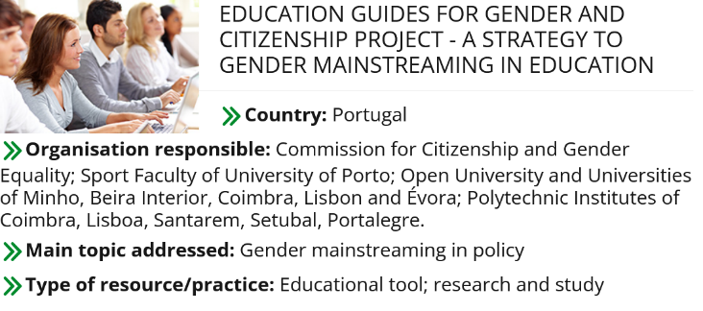
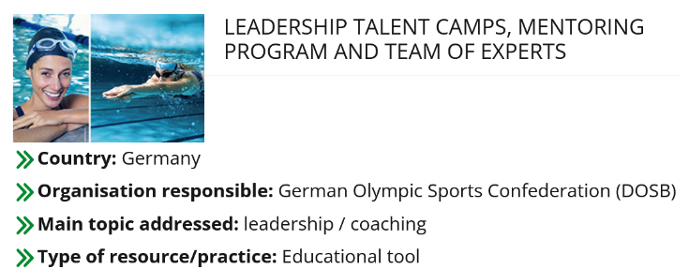
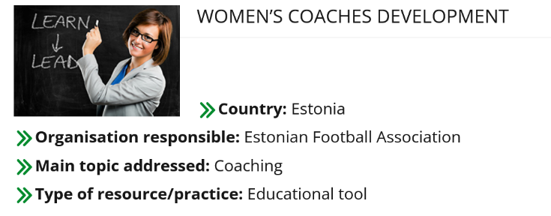
Strategies and good practice

Slide 30
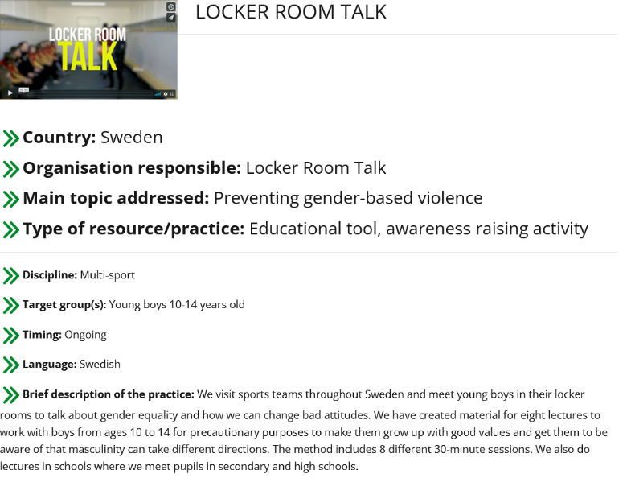
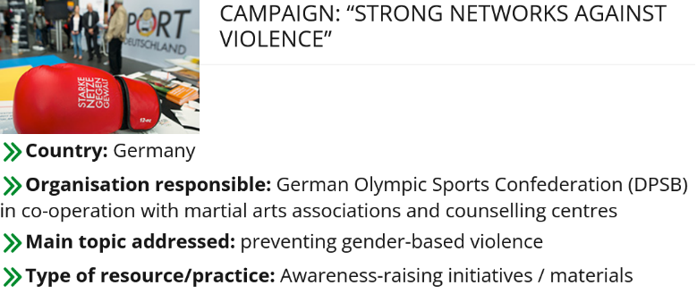
Strategies and good practice

Slide 31
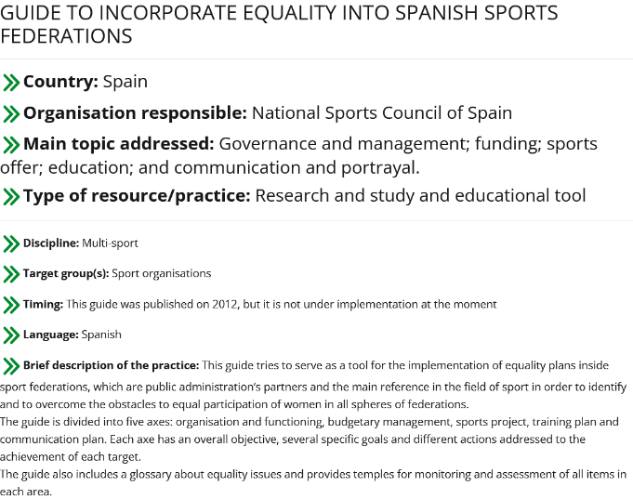
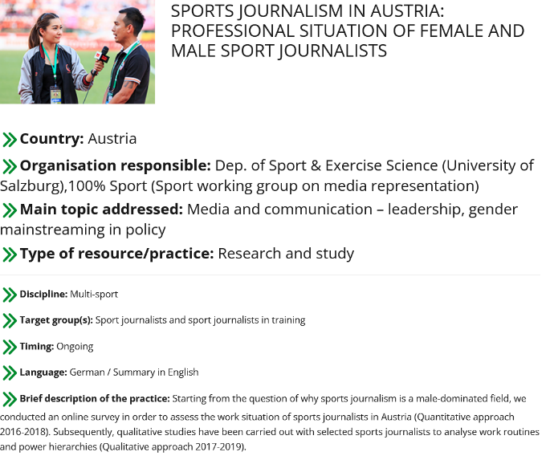
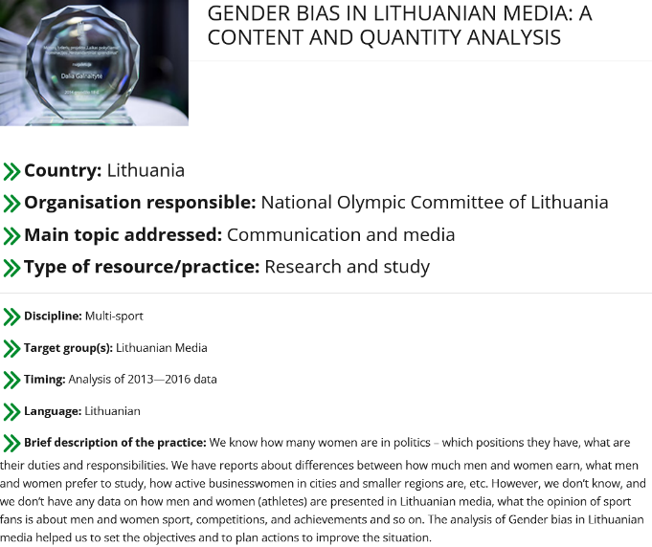
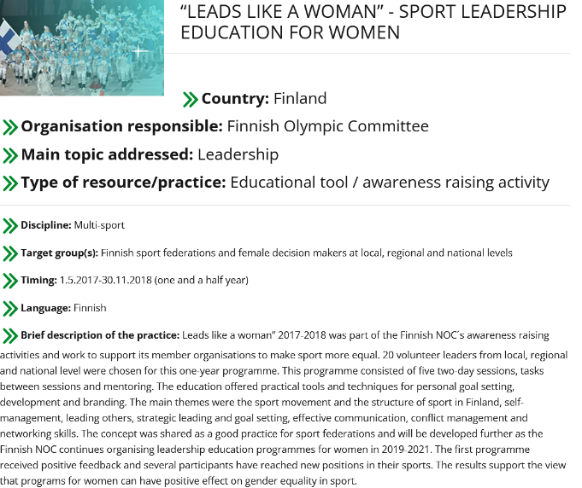
Strategies and good practice

Slide 32





Thank you!
gabriela.langhammerova@soc.cas.cz
facebook.com/NKCgenderaveda
twitter.com/NKC_CZ
instagram.com/nkc_gender_a_veda
linkedin.com/company/nkc-genderaveda
www.genderaveda.cz

Slide 33

Implementation, monitoring and sustainability of the GEP at the University of Gdańsk
Ewa Łojkowska
SUPPORTER Final Conference – Advancing Gender+ Equality in Widening Higher Education Institutions
Prague, 4-5 June 2025

Slide 34



UG path towards Gender Equality Plan
2016 - 2022 - participation in the H2020 funded projects on RRI STARBIOS2 and RESBIOS
2019 - a leader of a scientific consortium Towards Gender Harmony, funded by the National Science Centre in Poland, collecting data on GE and gender stereotypes in 62 countries and six continents.
2019 - Gender Indicator Report - for SEA-EU Alliance
2020 - establishment of UG Commission for Social Responsibility
2020 - first report showcasing data on Gender Equality at UG
„Women in science – diversity management
and Gender Equality in social responsibility of UG”
2021 - participation in the H2020 funded projects MINDtheGEPs

Slide 35
GEP Implementation Milestones 2022-2023
MINDtheGEPs Gender Equality Implementation Board (GEBIP) – August 2021
dedicated to design, implement and monitor GEP for UG
Rector of UG established Office of the Ombudsperson for Equal Treatment
& Anti-Mobbing – February 2021
Establishment of the MINDtheGEPS Delegates Network – May 2022 representatives of all the UG faculties and units, supporting GEP implementation
National Committee on Gender Equality within MINDtheGEPS – September 2022
Rector of UG established his Representative for Gender Equality Data Monitoring – March 2023
Carrying out GEP actions 2022-2023 + monitoring under coordination of the Commision for Social Responsibility of UG & GEBIP

Slide 36


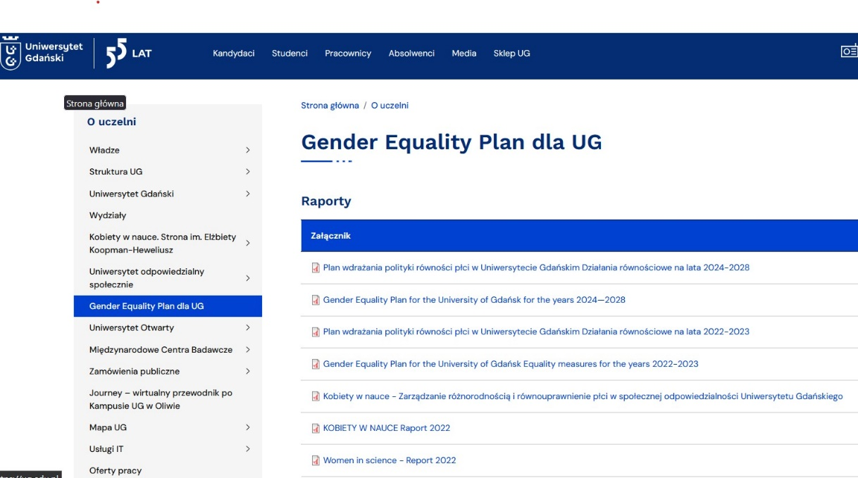
GEP for the UG - equality measures for the years 2022-2023
Approved by the UG Rector’s ordinance in December 2021
Implemented in 2022 - 2023
The GEP tab on the UG website links to documents in PL and EN

Slide 37
GEP for UG comprises 5 goals and 30 corresponding measures, as well as the indicators to be achieved
Goal 1. To enhance awareness of the importance of gender equality in the academic community
Goal 2. To ensure gender balance in the process of decision making at the UG
Goal 3. To ensure gender balance in the recruitment process and in the development of academic careers
Goal 4. To integrate the gender dimension into research and didactic content
Goal 5. To introduce measures to assist work-life balance

Slide 38
Goal 1. To enhance awareness of the importance of gender equality in the academic community
Trainings to counteract potential discrimination and harassment: office of the UG Ombudsperson of Equal Treatment and Anti-Mobbing held a series of meetings and trainings for UG community and on individual requests
A course „Discrimination and sexual harassment in the university - responding and countering” prepared for students, PhD students and staff members, available on the Staff and students UG portal.
Creating a dedicated webpage for Women in science on the UG (about 50 biographic entries published) + introducing female scientists to the local encyclopedia “GEDANOPEDIA”
Exhibitions promoting women in science:
1) “Pioneers, researchers, leaders. Women scientists of Gdansk” open-air exposition in the old town of Gdansk, followed by the display in all 3 universities campuses, accompanied by 4 panel discussions on the role of women in the development of Gdansk universities (2022, 2023)
2) “Female Scientists” (12 young, talented contemporary women-researchers presented) accompanied by presentations, debates and talks addressed to a wide-public audience
0

Slide 39
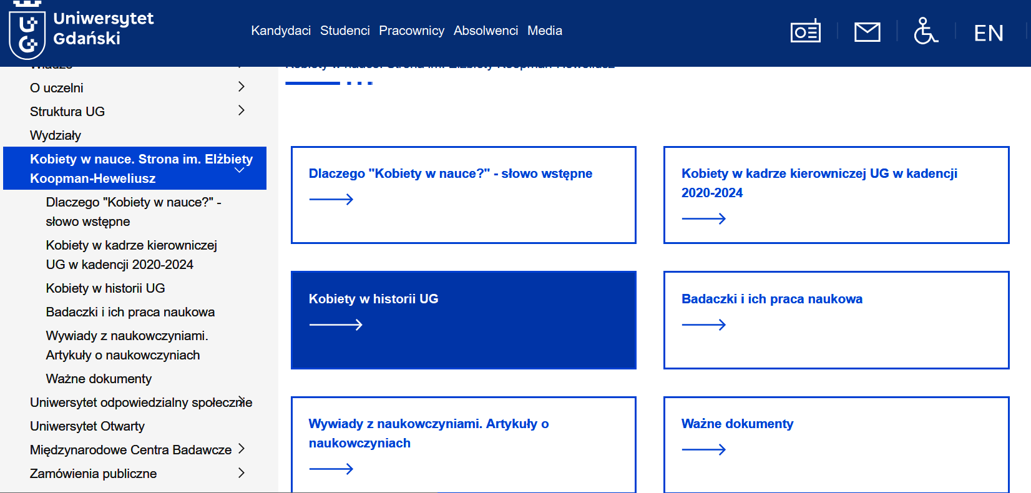

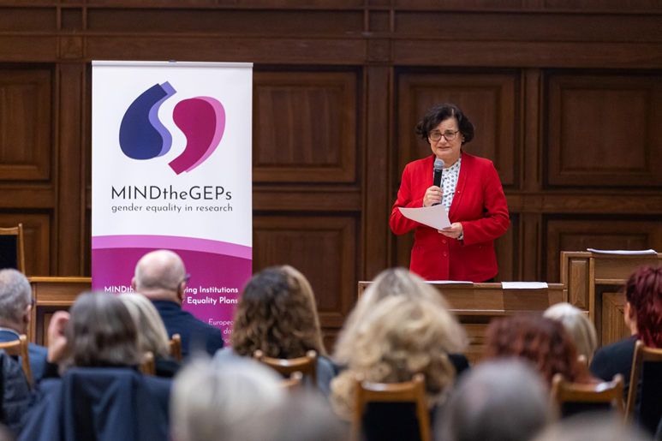
Goal 1. To enhance awareness of the importance of gender equality in the academic community
.

Slide 40
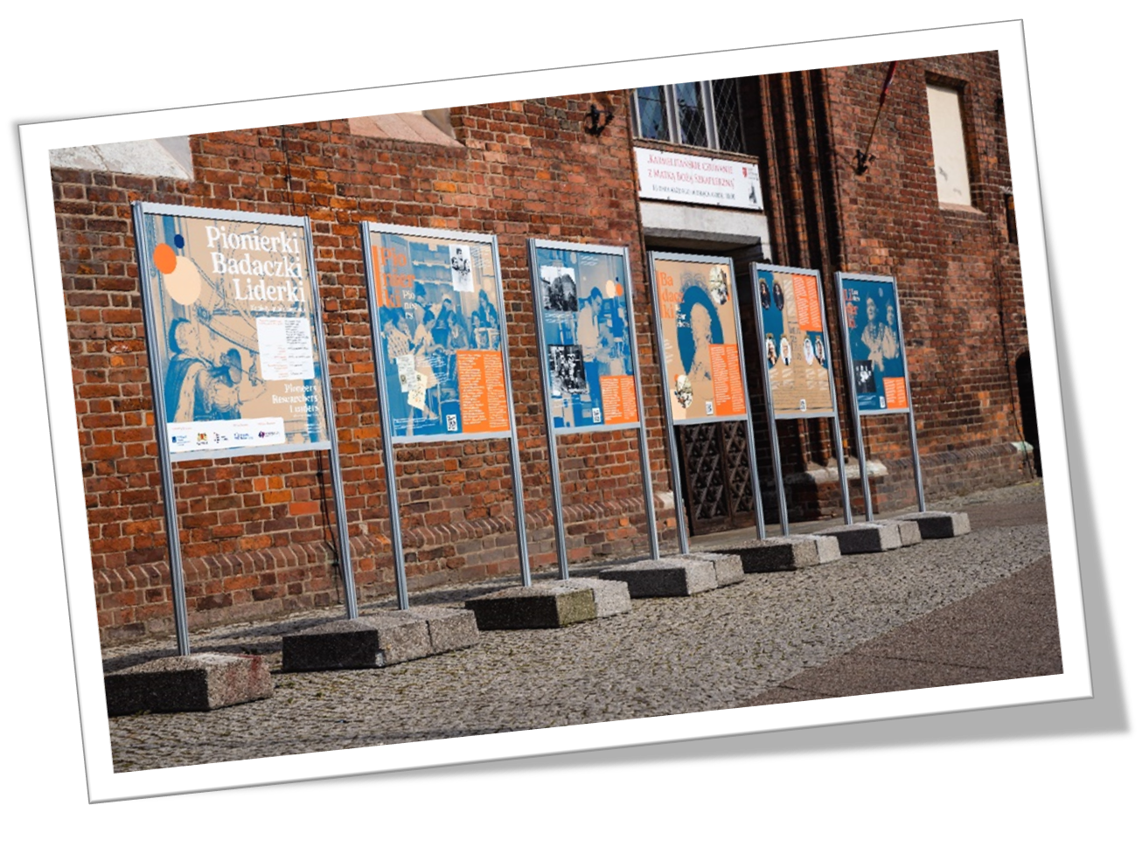
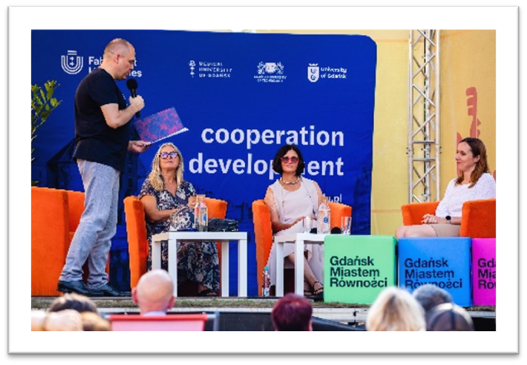
Goal 1. To enhance awareness of the importance of gender equality in the academic community

Slide 41
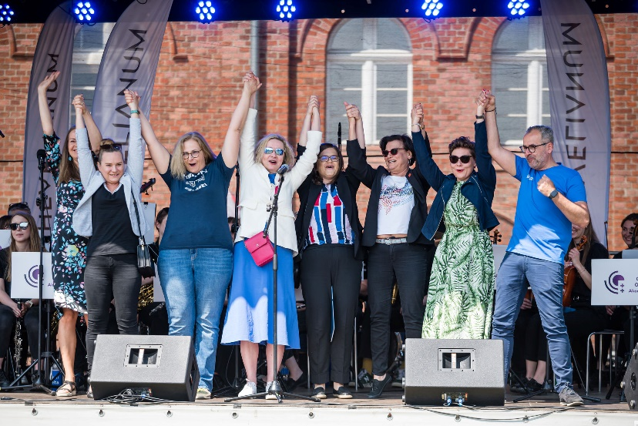
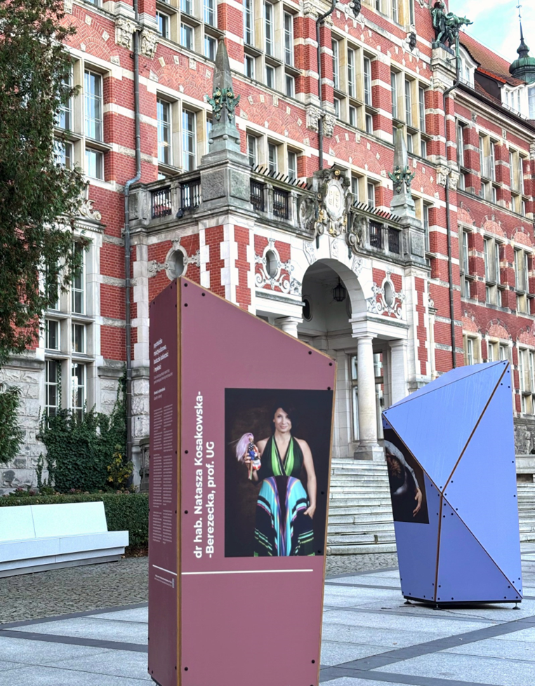
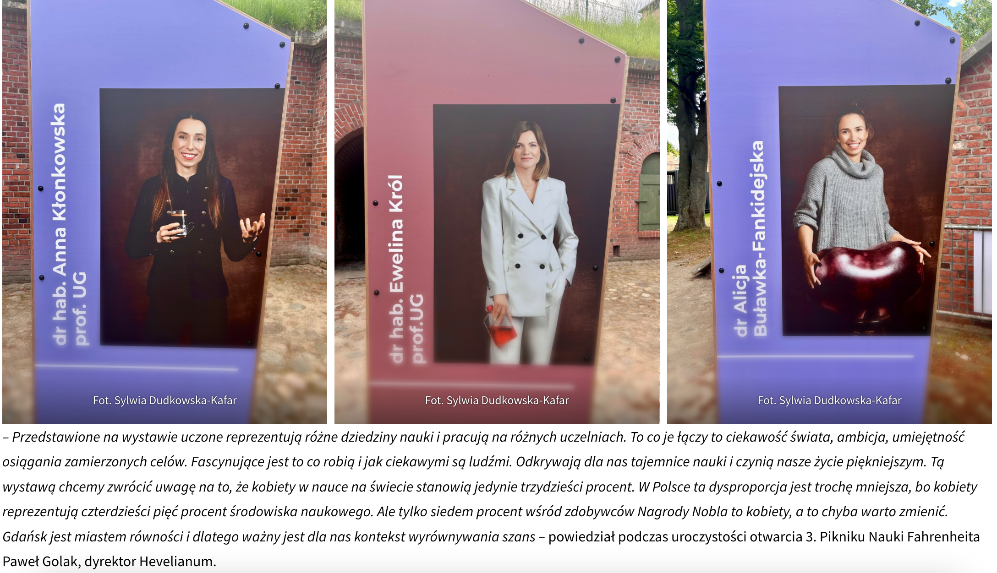
Goal 1. To enhance awareness of the importance of gender equality in the academic community
.

Slide 42

Goal 2. To ensure gender balance in the decision-making at the UG
Increase of the share of women in decision-making bodies and the Rector's Collegium –
vice-rectors for 2024 – 2028: 3 women out of 5 Vice - Rectors
Increase of women among faculty deans: 5 / 11 (2024-2028) 4/11 (2020-2024)
Appointment of the Rector’s representative for gender equality monitoring (March 2023) - responsible for collecting and reporting on gender balance and equality policy data at UG. This data also feed into the decision-making processes at the university level.
Training in leadership skills to eliminate gender bias among managerial and executive staff
Online courses for the UG female and male staff
Gender in careers and recruitment
Team management in the context of gender
Gendering research design and project preparation

Slide 43
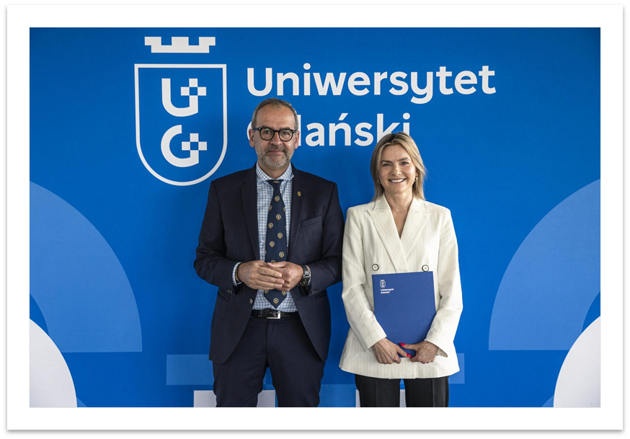
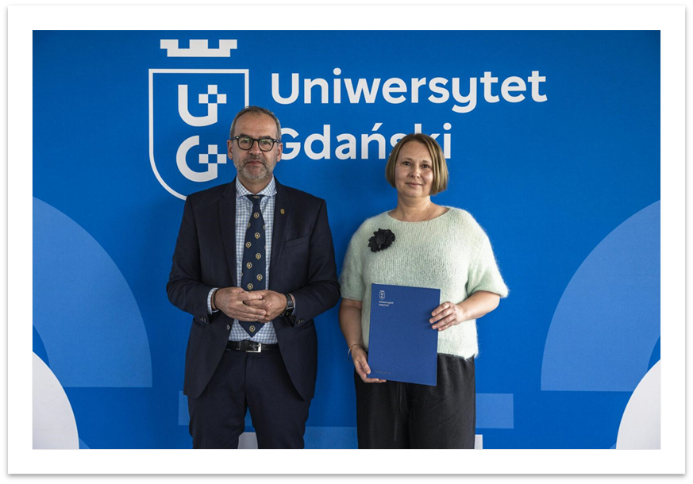
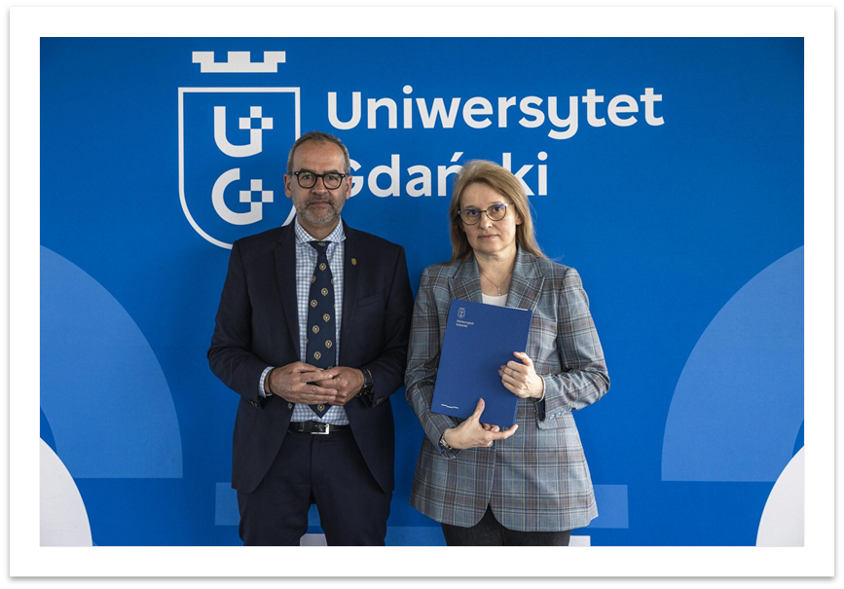
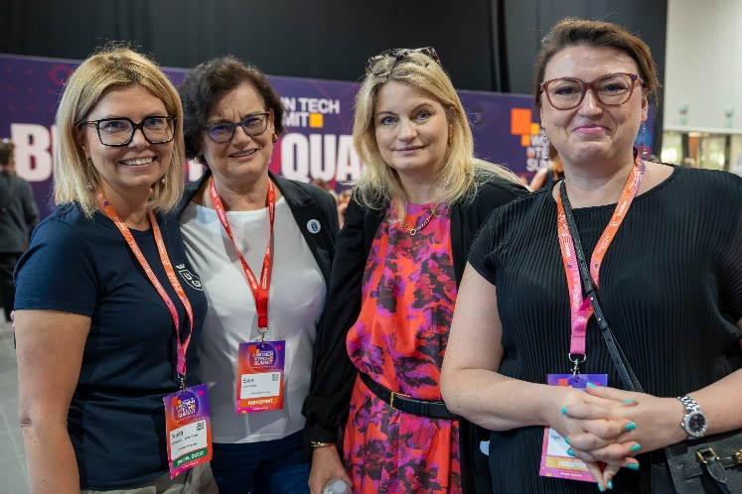
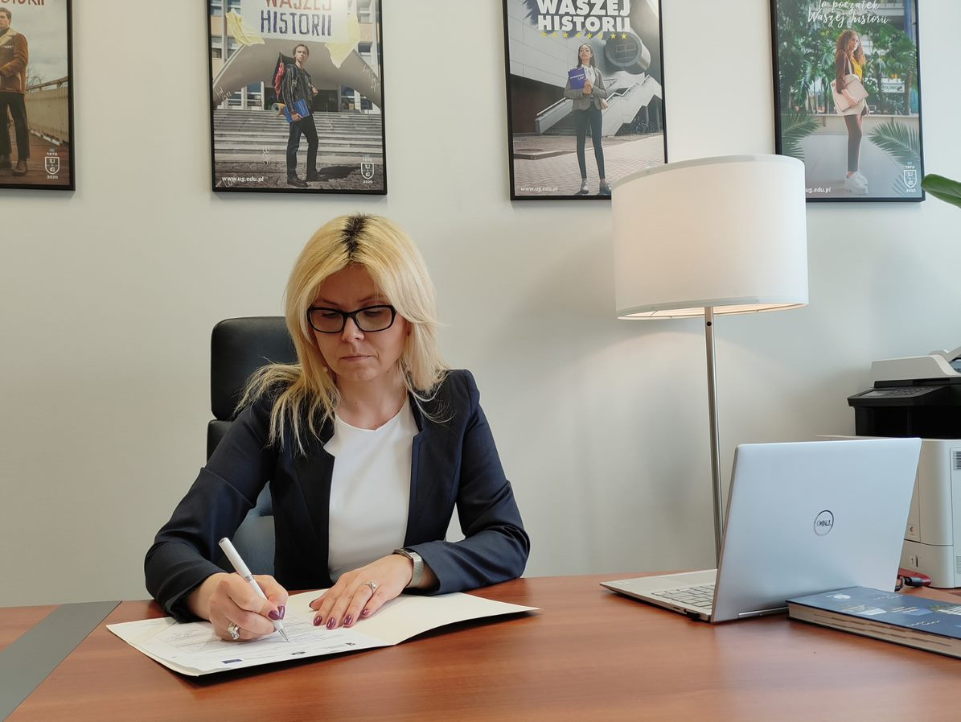
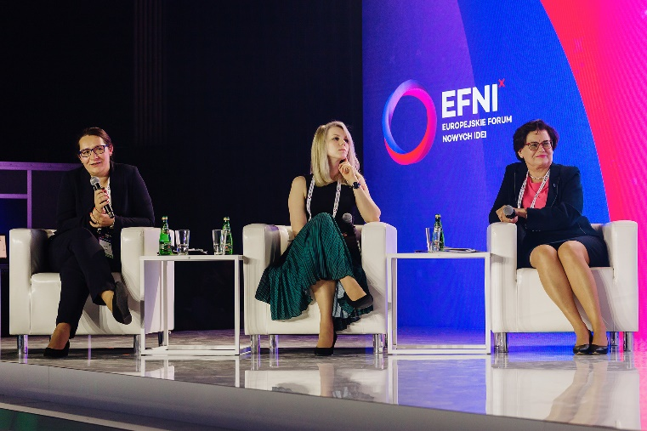
Goal 2. To ensure gender balance in the decision-making at the UG

Slide 44
Goal 3. To ensure gender balance in the recruitment process and in the development of academic careers
Supporting career development with equal opportunities focus
Two editions of Mentoring Programme to support career progression at UG and work-life balance in the cooperation with the UG Centre for Teaching Excellence and Tutoring completed:
    Dec 2022 – May 2023
  2) Oct 2023 – Feb 2024
3) Edition – 2024/2025 in progres
Recording of 3 video guidelines for career development advice on criteria to be met by applicants for the title of professor and degrees of habilitation and PhD - lectures by the expert of prof. Grzegorz Węgrzyn Head of the Polish Council of Scientific Excellence and interviews with the candidates on each career level

Slide 45

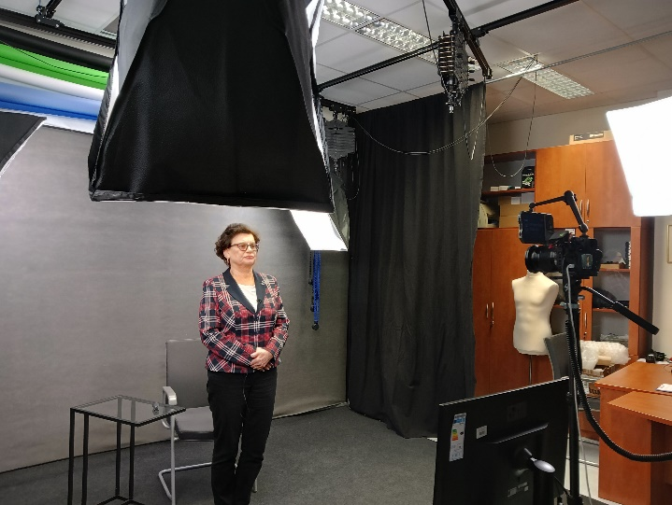
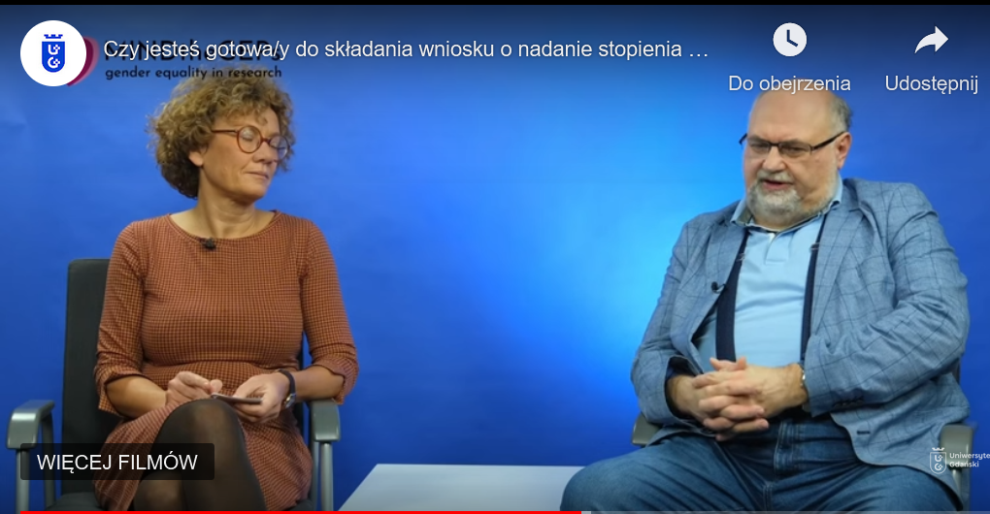
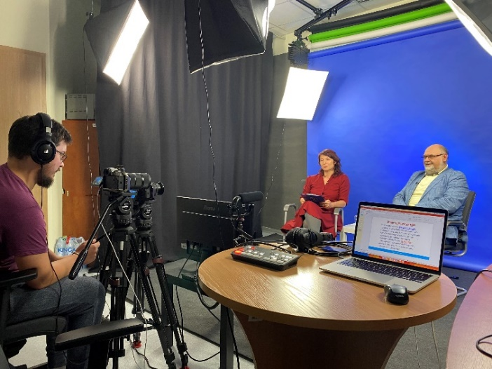

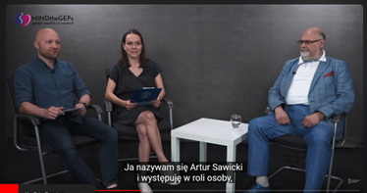
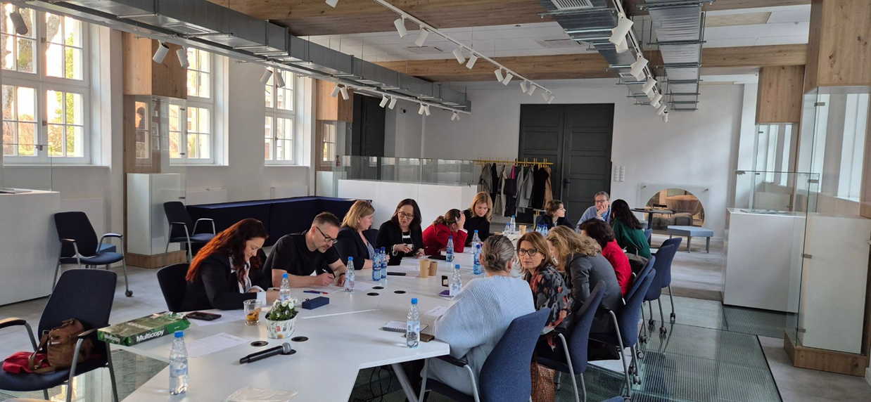
Goal 3. To ensure gender balance in the recruitment process and in the development of academic careers
5000 YT releases !

Slide 46
Goal 4. To integrate the gender dimension into research and didactic content
„I include gender in research” Award - 3 editions of the contest completed 2022, 2023, 2024
- annual awards for the best MA theses and PhD dissertations including gender dimension in the design and interpretation of research / awards granted during two International conferences in 2023 and 2024 organized by the Centre for Sustainable Development and during The Equality Day at UG in 2025.
1st edition of the Joanna Schopenhauer Arector’s Award - for female professors who include a gender perspective in their Research completed in 2024.
Including a question related to the inclusion of the gender dimension in the current UG project chart – questions incorporated into UG project application process
„ Does the project include gender perspective in the research content?”
„In which aspects does the project include gender perspective?”
Establishment in June 2023 the Fahrenheit University Women's Club Association - devoted to discuss inequalities between men and women in academia; 7meetings of the FarU Women’s Club.

Slide 47

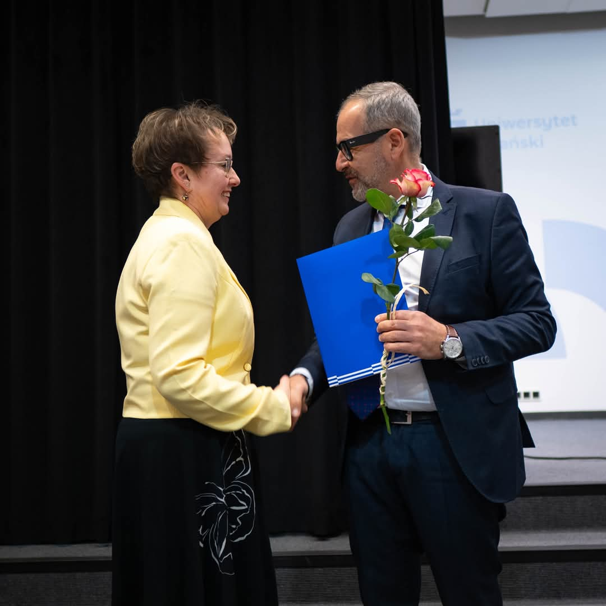
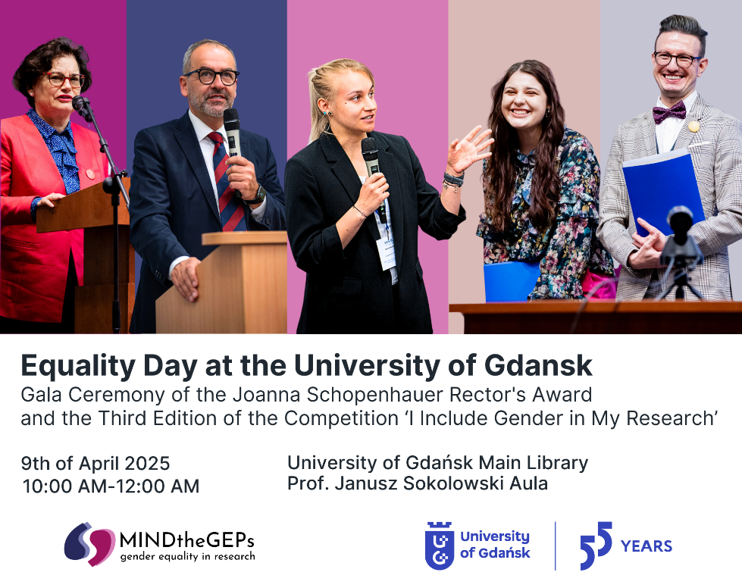
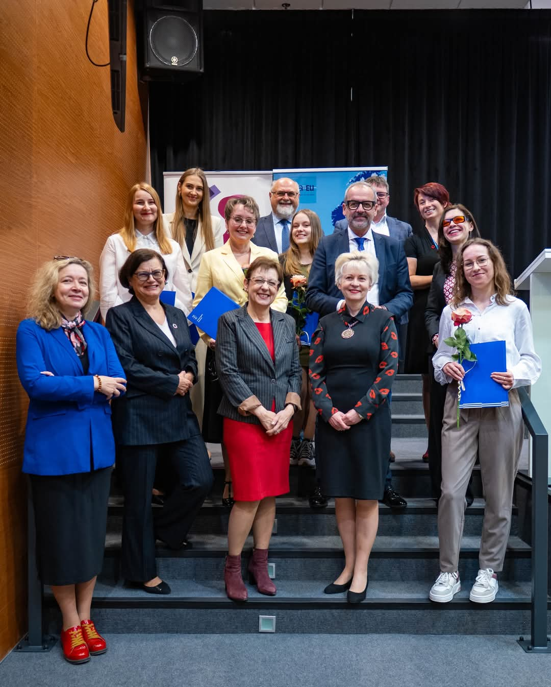
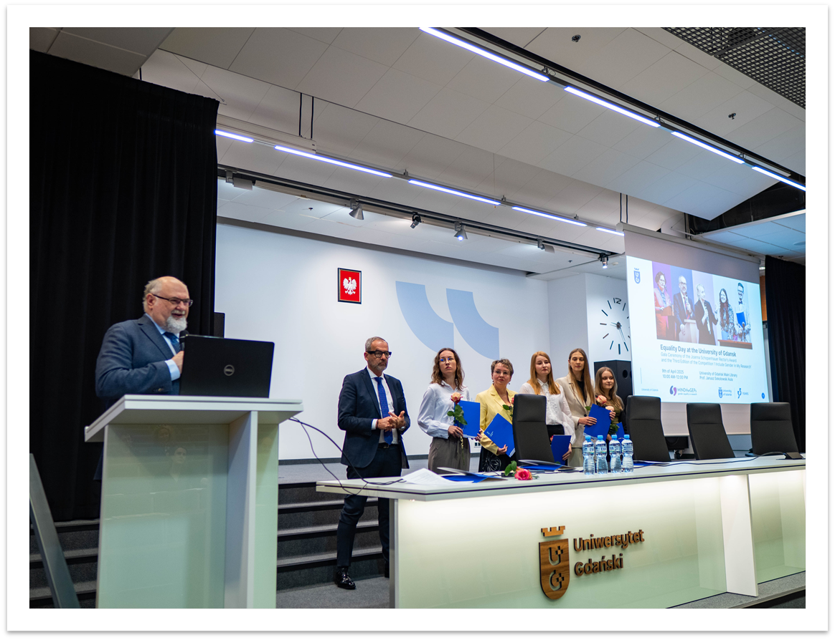
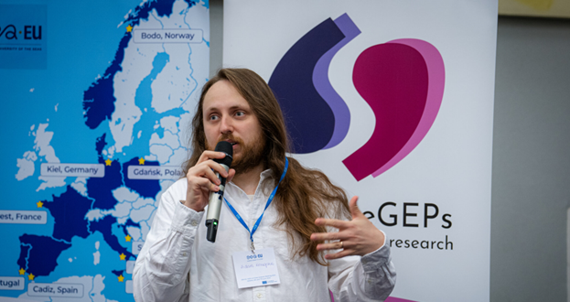
Goal 4. To integrate the gender dimension into research and didactic content
.

Slide 48





Slide 49
Goal 5. To introduce measures to assist work-life balance
Introducing obligatory online training to increase awareness of the importance of gender equality related issues — Module “Work-life balance”.
Regulations introduced on remote work/ flexible time solutions due to family-related issues.
Tab on the UG website on information on the parental care rights / staff with disabilities / benefits offer for all staff - HR and Social Affairs Departments websites.

Slide 50




Goal 5. To introduce measures to assist work-life balance
Promotion and information campaign on fathers leave - Video - guidelines on regulations for fathers - recording on legal regulations on parental entitlements - lecture by law expert prof. Monika Tomaszewska and interview conducted with fathers who took fathers leave

Slide 51






Goal 5. To introduce measures to assist work-life balance
Establishing 2 family rooms in UG units (ICCVS & IFB ) for parents/ caregivers with small children - initiative supporting UG staff in keeping work-life balance

Slide 52


UG GEP’s recognition
UG awarded in the area ‘Equality mechanisms’ being among top 3 public institutions in Poland promoting women within the competition: Pro-women company of the year 2024 organized by Kulczyk Foundation, Association Women’s Congress and Confederation Lewiatan. (September 2024).
UG ranked first in Poland and 13. and 16. globally in terms of the implementation of the Objective 5. Gender equality of the 17 UN SDG, according to the Times Higher Education Impact Ranking 2023 and 2024 respectively
UG invited to join the WIGE CoP –INSPIRE Programme – European Centre of Excellence on Inclusive Gender Equality in Research & Innovation: Creating Knowledge & Engaging in Collaborative Action (February 2025)

Slide 53



UG GEP’s recgnition
EU Gender Equality Champion in Research and Innovation
University of Gdańsk - Newcomer Gender Equality Champion 2024
„The University of Gdansk has made impressive strides in gender equality by implementing its first Gender Equality Plan. This initiative has also inspired and supported other institutions in the region and beyond. ”
EU Commissioner Ekaterina Zaharieva
A prize of €100,000 for the University of Gdańsk
The prize is designed by the European
Commission Directorate-General for
Research and Innovation, managed by
the European Research Executive Agency

Slide 54

GEP for 2024 - 2028
GEP is in compliance with the University of Gdansk Strategy 2025-2030 - Goal 3: Openness, Social Responsibility, and Internationalisation of the University -
GEP 2024-2028 is focused on the development and implementation of a model of social inclusion, building a sense of security, counteracting discrimination and social inequality and creating academic culture of equity

Slide 55
Sustainability effects of the GEP’s actions
„I include gender in research Award” for MSc and PhD thesis
- Rector’s funding (from 2024)
- expanding award for Post Doctoral researchers (from 2025)
Joanna Schopenhauer Rector’s Award for women professors (from 2024)
Mentoring programme insite and beyond UG – training for potential mentors from 3 Fahrenheit universities (March 2024
Webpages development: Women in UG and Senate’s Commission for Social Responsibility
Fahrenheit Women’s Club integrating women and men from 3 Gdansk universities and jointed by members from other academic and non-academic institutions, art academies, cultural institutions, local authorities, NGO’s and others.

Slide 56

Sustainability effects of the GEP’s actions/institutional level
Gender balanced composition of UG authorities - more women among Rector’s collegium and at the leadership positions
New nominations for Vice-Rectors in UG for 2024 – 2028: 3 women out of 5 Vice - Rectors
In the Fahrenheit Union of the Gdańsk University (FarU) we had:
2 female vice-rectors and 10 male vice-rectors in the term 2016-2020
5 female vice-rectors and 9 male vice-rectors in the term 2020-2024
8 female vice-rectors and 8 male vice-rectors in the term 2024-2028.

Slide 57
Sustainability effects of the GEP’s actions
Office of the Ombudsperson for Equal Treatment & Anti-Mobbing – February 2021
Rector’s Representative for Collecting and Monitoring Gender Equality data (March 2023)
Senate’s Commission for Social Responsibility (Sep 2024)
Rector’s Statements on: (1) using feminatives (Nov 2024) and (2) inclusive procedure for students and doctoral students with special needs (March 2025)
Rector’s Representative for Monitoring and Evaluation of GEP (May 2025)

Slide 58
Sustainability effects of the GEP’s actions
Mandatory courses included in the Doctoral Schools study program:
Managing Diversity in the Academic Environment (in-person, mandatory);
Discrimination and Sexual Harassment at the University - Response and Prevention (online, mandatory);
Equality and Balance in Research Projects (online, recommended);
Implementing Gender, Diversity, and Equality Perspectives in Teaching (in-person, mandatory).

Slide 59
Sustainability effects of the GEP’s actions
Introduction of the courses available on the online platform for heads of departments and research team leaders:
Managing Diversity in the Academic Environment (in-person, mandatory);
2. Discrimination and Sexual Harassment at the University - Response and Prevention (online, mandatory);
3. Equal Treatment in Recruitment Processes and Career Development (online, mandatory).

Slide 60
Sustainability effects of the GEP’s actions
IIntroduction of courses available on the online platform for :
ALL STAFF:
Discrimination and Sexual Harassment at the University - Response and Prevention (online, recommended);
Equality and Balance in Research Projects (online, recommended).
ALL STUDENTS:
Discrimination and Sexual Harassment at the University - Response and Prevention (online, recommended);
Managing Diversity in the Academic Environment (online, recommended);
Equality and Balance in Research Projects (online, recommended).

Slide 61

We include all…. and more!

Slide 62

Thank you for your attention!
We are happy to share and learn! Lety’s stay in touch!
www.ug.edu.pl

Slide 63
Promoting gender equality in sports
Sustainable actions and role of University of Ljubljana, Faculty of Sport
Katjuša Radinovič, Head of the research office
Prague, 5. 6. 2025

Slide 64





About the Faculty
Leading national higher education and research institution in the field of kinesiology and sport in Slovenia.
Mission: Excellence, innovation, and social responsibility through sport.
Inclusive, safe, and stimulating environment for all.
Notes:
3 Bachelor's degrees
3 Master's degrees
1 Doctoral study programme
2 Research programmes
60 projects
2 Scientific Journals

Slide 65

UL FŠ - current gender representation

Slide 66
Our commitment to gender equality
Gender equality as a pillar of academic and sporting excellence.
UL FŠ GEP.
4I approach - intersectionality, innovation, inclusiveness, impact.
Addressing systemic barriers and combating discrimination.
Promoting gender equality in sport.
Notes:
UL FŠ GEP alignment with the Gender equality plan of our University and EU guidelines.
Key pillars of our GEP (4I approach) - intersectionality, innovation, inclusiveness, impact

Slide 67

Sustainable measures and goals of UL FŠ GEP
Data collection and monitoring.
Preventing violence, harassment, and discrimination.
Promoting gender equality in sport.

Slide 68
Promoting gender equality in sport – our focus
Cooperation with the Slovenian Olympic Committee and national sports federations.
Incorporating gender equality topics into continuous professional development programs.
Gender equality topics as a permanent feature in continuous professional development programs.
Measure impact and adjust based on feedback.
Notes:
Regular meetings with the Slovenian Olympic Committee and sports federations.

Slide 69

Why this focus?
Raising awareness, reduces discrimination and promotes inclusivity.
Coaches influence the sports environment and athlete experience.
Grassroots change is essential for long-term impact.

Slide 70

Example
Training session implemented for coaches - collaboration with the Slovenian Olympic Committee.
Topics:
Importance of gender equality.
GEP.
Recognizing unconscious biases.
Strategies for inclusivity in coaching.
Notes:
1. Sport Professional, Level 1 - Recreational Sport
2. Sport Professional, Level 1 - Sport for the Elderly
Alltogether 40 participants
Event details: We incorporate the two workshops into already planned trainings of the Slovenian Olympic Committee (we have chosen this format because we believe it will make it easier to attract the right participants).
Title of the event: working version
Gender equality in recreational sport - where are the opportunities for improvements?
Description:
Each workshop will be held in two parts:
Theoretical part: presentation of the basics of discrimination and gender equality.
Practical part – group work: 1st part - identifying gender equality problems in recreational sports, 2nd part - finding solutions.
Posebnega vabljenja ni bilo – že predvideno usposabljanje

Slide 71

Feedback from implemented training session
Notes:
Valuable workshop topic: Participants found the topic of gender equality in recreational sports highly relevant and important.
Combination of theory and practice: The mix of theoretical introduction and practical group work was particularly appreciated for bridging knowledge and real-world application.
Opportunities for collaboration: Participants liked the group work format, which encouraged them to collaboratively discuss and develop potential solutions to gender equality challenges.
Real-life relevance: The workshops helped participants connect gender equality issues directly to their own experiences in sports.
Raising awareness and critical thinking: Feedback showed that the sessions successfully raised awareness and encouraged deeper reflection on the topic.
Integration into existing programs: The integration of these workshops into established training programs was seen as effective for reaching those already active in the field.

Slide 72

Broader Impact
Gender equality strengthens the sports system.
Creates better opportunities for all athletes and coaches.
Coaches as role models.
Essential for the integrity and success of sports.

Slide 73

Notes:
Nelson Mandela

Slide 74
Thank you!
E-mail: raziskovalna.pisarna@fsp.uni-lj.si
Website: www.fsp.uni-lj.si
Facebook: https://www.facebook.com/fakultetazasport

Slide 75
SUPPORTER final conference
Advancing Gender+ Equality in Widening Higher Education Institutions
Wrap up
Maria Sangiuliano
research director
at Smart Venice

Slide 76
Our platforms

Slide 77
Survey time!

