Slide 1
SUPPORTER final conference: Advancing Gender+ Equality in Widening Higher Education Institutions
Day 1: Creating safe and inclusive ecosystems in sports and higher education: How students can make a difference
Prague, 4 June 2025

Slide 2
SUPPORTER final conference
Advancing Gender+ Equality in Widening Higher Education Institutions
Opening statements
Irena Smetáčková (CZE)
Head of the department of psychology at
The pedagogical faculty of Charles University

Slide 3
SUPPORTER final conference
Advancing Gender+ Equality in Widening Higher Education Institutions
Presentation 1:
Gender equality and gender-based violence in sport higher education
Nathalie Wuiame, University of Gotherburg

Slide 4
Quiz: can we recognise gender-based violence and the role of our organisation?

Slide 5
Is it gender-based violence?
RAISE YOUR HAND IF YOU AGREE THAT THIS IS GBV!
Made you take part in any form of sexual activity when you could not consent because you were asleep, drunk or drugged.
Directed abusive comments towards you (e.g., demeaning, humiliating, offensive or ridiculing comments).
Interrupted you, spoke over you or addressed you in disrespectful terms in front of others.
Ignored you or did not speak to you.
Notes:
Can be a student,, a professor, a coach, ….

Slide 6
Is it the responsibility of my university to protect me when it happens…?
RAISE YOUR HAND IF YOU AGREE THAT the University can act!
A break room, canteen or cafeteria.
A residential accommodation.
Sport premises outside of the Institution’s premises.
In the evening, in connection with an activity not related to study or work but connected to your institution.
Online, e.g., threats via social media groups (linked to University activities), email, messages, or virtual learning platforms.

Slide 7
Gender equality and gender-based violence in sport and academia

Slide 8
Glossary
Gender equality means an equal visibility, empowerment and participation of both sexes in all spheres of public and private life. It aims to promote the full participation of women and men in society.
Gender-based violence refers to all forms of violence, violations, and abuse that are based on gender and go beyond narrow legalistic definitions.
Gender-based violence is part of a wider system of dominance and power inequalities that goes beyond a binary understanding of gender and may include sexist (and racist) hostility/threats.​

Slide 9
Equality and violence in sport
Participation in sport can expose individuals, especially women and girls, to various forms of violence, for example:
Contact sports can lead to increased incidents of aggression and physical harm, either during competition or training.
Pressure to perform, body shaming, or verbal intimidation can contribute to emotional trauma, which may be perpetuated by toxic coaching practices or hyper-competitive cultures.
Source, UN Women & UNESCO, Handbook on Tackling Violence Against Women and Girls in and through Sport?
Notes:
https://www.unwomen.org/sites/default/files/2023-07/3343_unwomen_unesco_vawg_handbook_6a_singlepage.pdf

Slide 10
Context matters !
Importance of athletic identity: no possibility to leave or disclose abuse behaviours.
Active silencing: fear of retaliation or not taken seriously.
Normalisation of harm: normal or even necessary for athletic development and success.
Source: Infography prepared by the Faculty of Kinesiology and Physical Education, University of Toronto

Slide 11
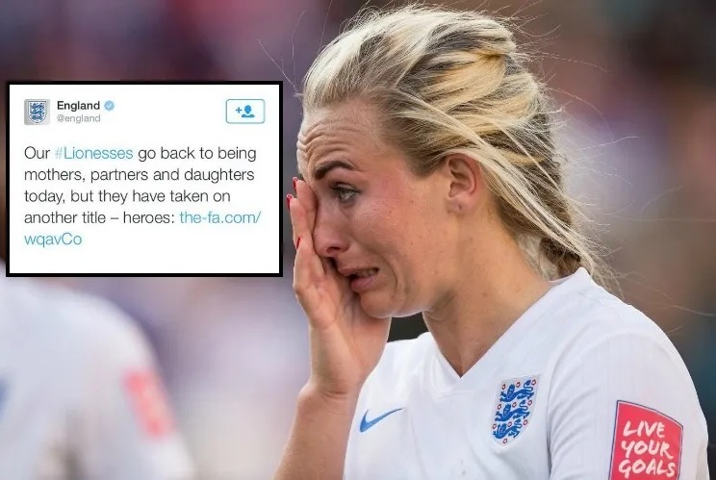
Normalisation of sexist and harmful comments
Notes:
Women and girls may face sexist attitudes, exclusion, or hostility within male-dominated sports environments, which can discourage participation and compromise their safety and dignity.

Slide 12
GBViolence in Higher education: UniSAFE Survey

Slide 13
Frequency of gender-based violence – UniSAFE findings

Slide 14
Violence as a system that exclude and discriminate
A violation of human rights
An extreme expression of gender inequalities
A simultaneous cause and consequence of gender inequality
-> Dismissing the narrative of gender-based violence as isolated, individual and deviant incidents; instead, gender-based violence as part of a wider system of dominance, oppression and power.

Slide 15
Main types of gender-based violence dyads
Violence from … towards …:
Staff towards staff
Student towards student
Staff towards student
Student towards staff
Other towards staff
Other towards student
…
Typically, staff face violence from colleagues and other co-workers, or their superior
For students, perpetrators are more likely to be other students, and acquaintances associated with the institution, though there are some incidents involving (teaching) staff

Slide 16
Violence as a system, a continuum, and intersectional
Physical violence
All forms of gender-based violence are inter-related
Gender is shaped by other inequalities
Sexual violence
Psychological violence
Sexual harassment
Economic violence
Online violence
See e.g. Strid & Meier-Arendt, 2019; Strid et al., 2021; Hearn et al., 2021, 2022; Humbert, Strid et al., 2024

Slide 17
What to do?

Slide 18
Opportunities and possibilities for universties and higher education institutions
Perception: experiences of gender-based violence are expected for a majority of students and staff in the European Research Area.
Precision: shift from a reactive, policy-centred, binary, singular event to a proactive, survivor-centred, intersectional, process of abuse and recovery
Priority: ending gender-based violence will lead to achieving quality and excellence in research and innovation
Precious: acknowledge inclusive, restorative, feminist claims on epistemic justice as a stairway to academic freedom

Slide 19
Resources
GenderSAFE : introductory training in English, Czech, French, Greek, Italian and Spanish.
https://gendersafe.eu/gendersafe-trainings/
UniSAFE toolkit: guidance on designing effective policies and implementing concrete measures - inspiring practices
https://unisafe-toolkit.eu

Slide 20
SUPPORTER final conference
Advancing Gender+ Equality in Widening Higher Education Institutions
Panel discussion on gender equality and gender-based violence
in the sports ecosystem

Slide 21
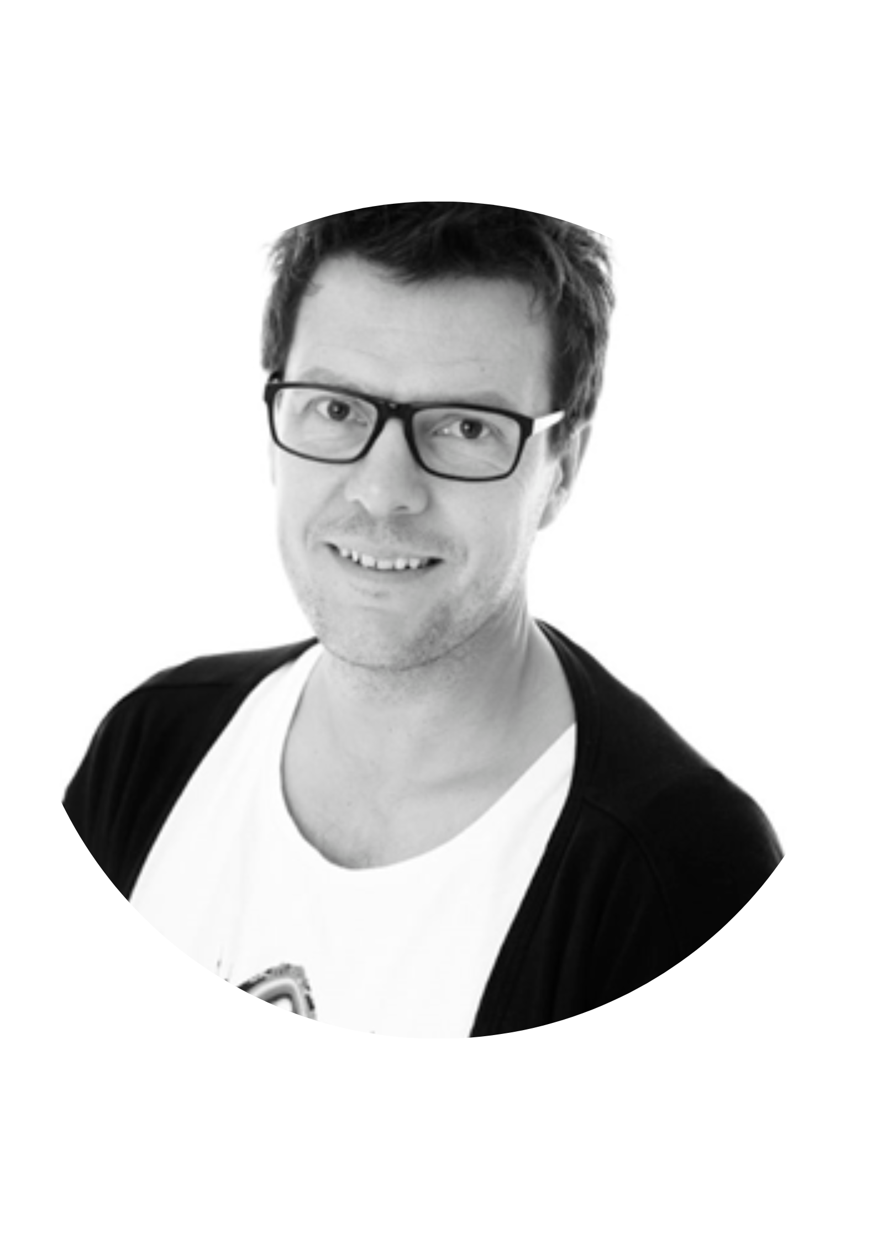
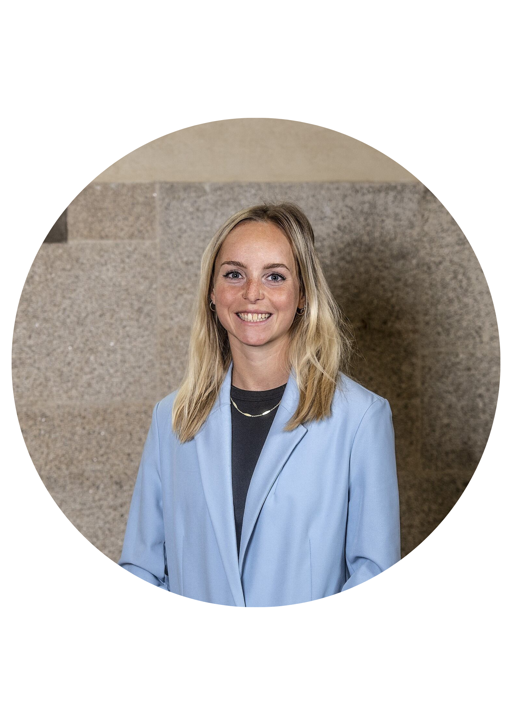
SUPPORTER final conference
Advancing Gender+ Equality in Widening Higher Education Institutions
Panel discussion on gender equality and gender-based violence in the sports ecosystem
Michaela Šebelová
Member of the Chamber of Deputies of Czech Republic
Jana Havrdová
President of Czech Chamber of Fitness and Czech Aerobics Association
Daniel Alsarve
Associate Professor in sport science at Örebro University
Andrea Duchoňová
PhD candidate at the Faculty of Sports at Charles University

Slide 22
SUPPORTER final conference
Advancing Gender+ Equality in Widening Higher Education Institutions
Presentation: What to do? How can students address gender-based violence in both contexts?
Panagiota Polykarpou, Yellow Window

Slide 24
CULTURE OF SILENCE
24

Slide 25
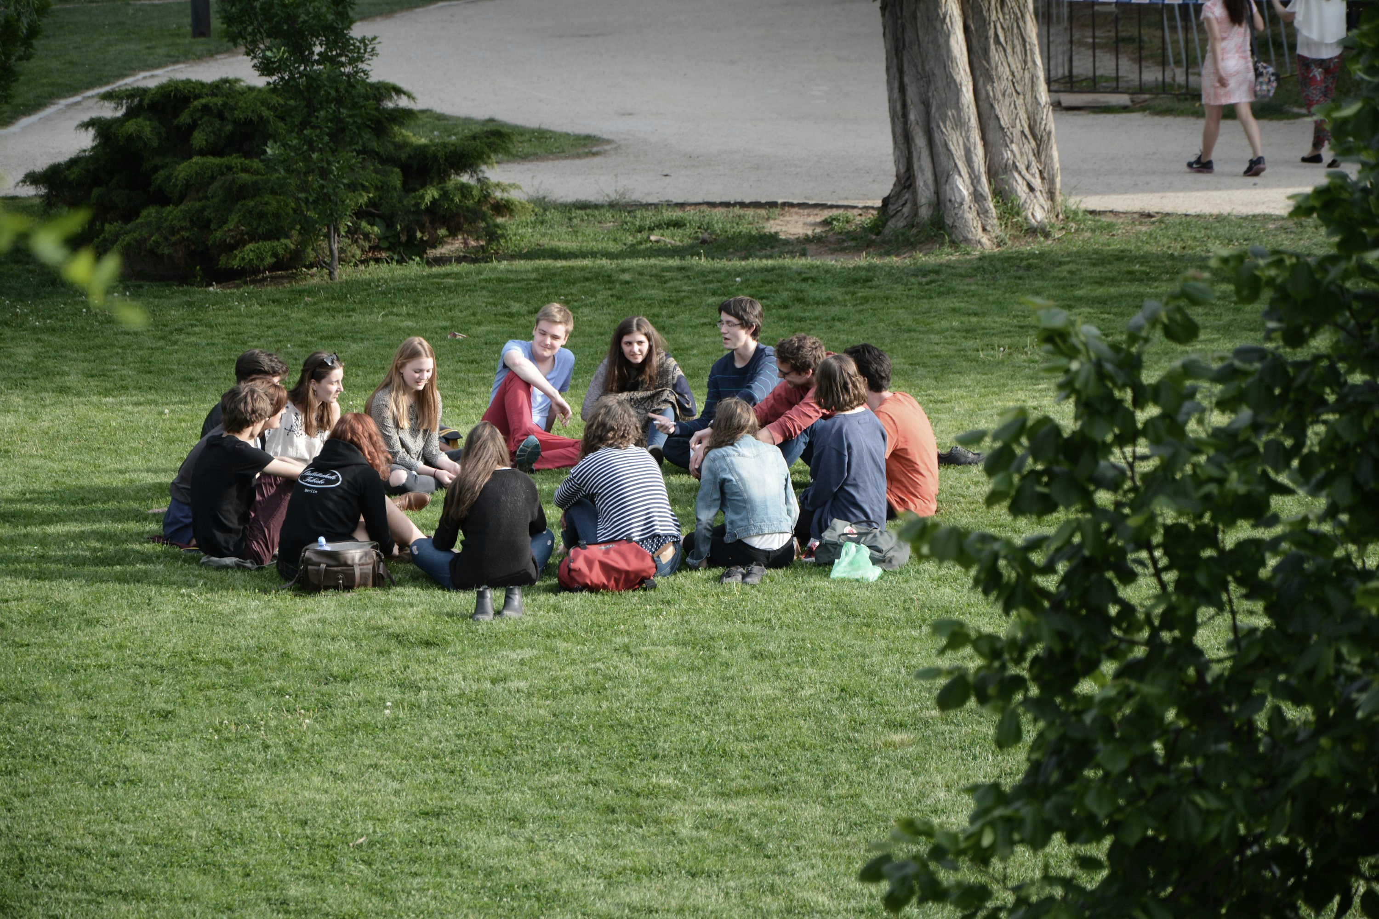

Slide 26
WHAT CAN I DO?
26

Slide 27
Step 1: Recognise that something is happening
Bystander model

Slide 28
Step 2: Assume responsibility
Bystander model

Slide 29
Step 3: Choose how to help and take action
Bystander model

Slide 30
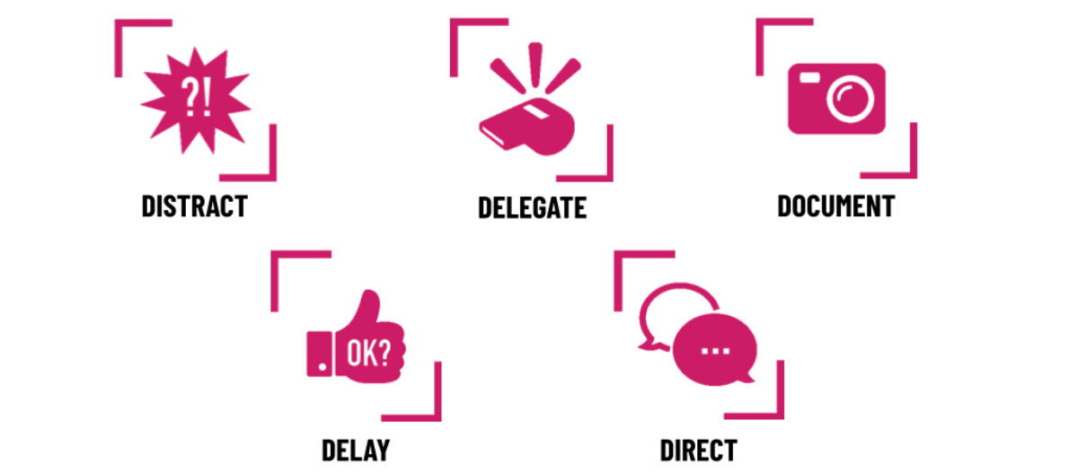
5Ds by Right To Be

Slide 31
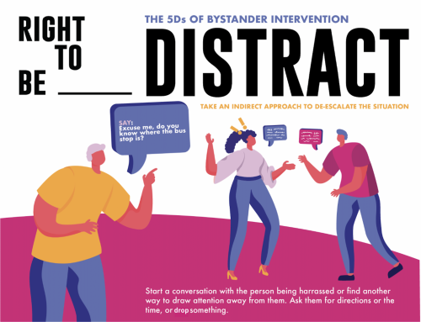
Ignore the person who is harassing and engage directly with the person who is being harassed.
Don’t talk about or refer to the harassment that’s happening. Instead, talk about something completely unrelated.
Source: Right to be

Slide 32
Look for a delegate who is ready and willing to help.
When you delegate someone to help you, clearly state what you’re witnessing and how you’d like them to help.
Source: Right to be

Slide 33
Always ask the person who was harassed what they want to do with your recording and/or notes.
Never post it online or use it without their permission.
Source: Right to be

Slide 34
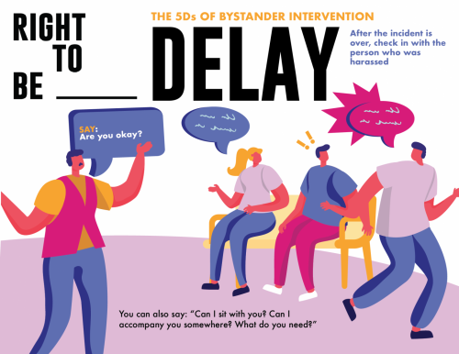
When it’s safe, check in with the person who was harassed. Stay with them for a while until they feel safe.
Let them know that you saw what happened and it wasn’t okay.
Ask them if there’s any way you can support them.
Offer to accompany them to their destination or sit with them for a while.
Source: Right to be

Slide 35
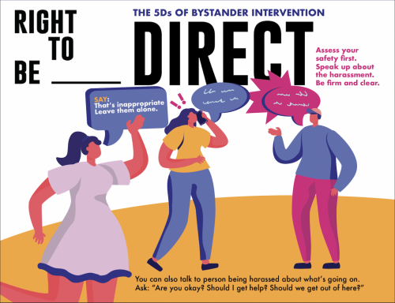
1. Are you physically safe?
2. Is the person being harassed physically safe?
3. Does it seem unlikely that the situation will escalate?
4. Can you tell if the person being harassed wants someone to speak up?
If you can answer yes to all of these questions, you might choose a direct response.
Keep it short and succinct.
Source: Right to be

Slide 36
CULTURE OF SILENCE
WE CAN BREAK THE
36

Slide 37
WHAT CAN WE DO?
37

Slide 38
Why We Did Not Report — Charles University
Anonymised posters sharing real student experiences with harassment or violence
Exhibited stories at the university cultural centre
Public panel discussions to break the silence, reduce stigma, and point students to support services
38

Slide 39
Emergency Taxi Scheme — Edinburgh University Students’ Association
A student-led safety net for late-night emergencies
Focused on physical safety
An example of practical, collective action changing campus culture
39

Slide 40
Never OK Campaign and SafeZone App – University of Manchester, Manchester Metropolitan University and University of Salford, United Kingdom
Builds a zero-tolerance culture for harassment and violence
Empowers students as active bystanders to challenge harm
Provides an “Understanding Consent” module + reporting tools
Includes the SafeZone App for real-time safety on and off campus
An example of multi-university collaboration for cultural change
40

Slide 41
Solidarity Network of Victims of Gender Violence in Universities, Spain
Peer-led support network for survivors of gender-based violence
Offers solidarity, listening, and accompaniment through experiences
Provides an online platform for additional, non-institutional support
An example of students creating safe spaces for each other
41

Slide 42
WHAT WILL YOU DO?
42

Slide 43
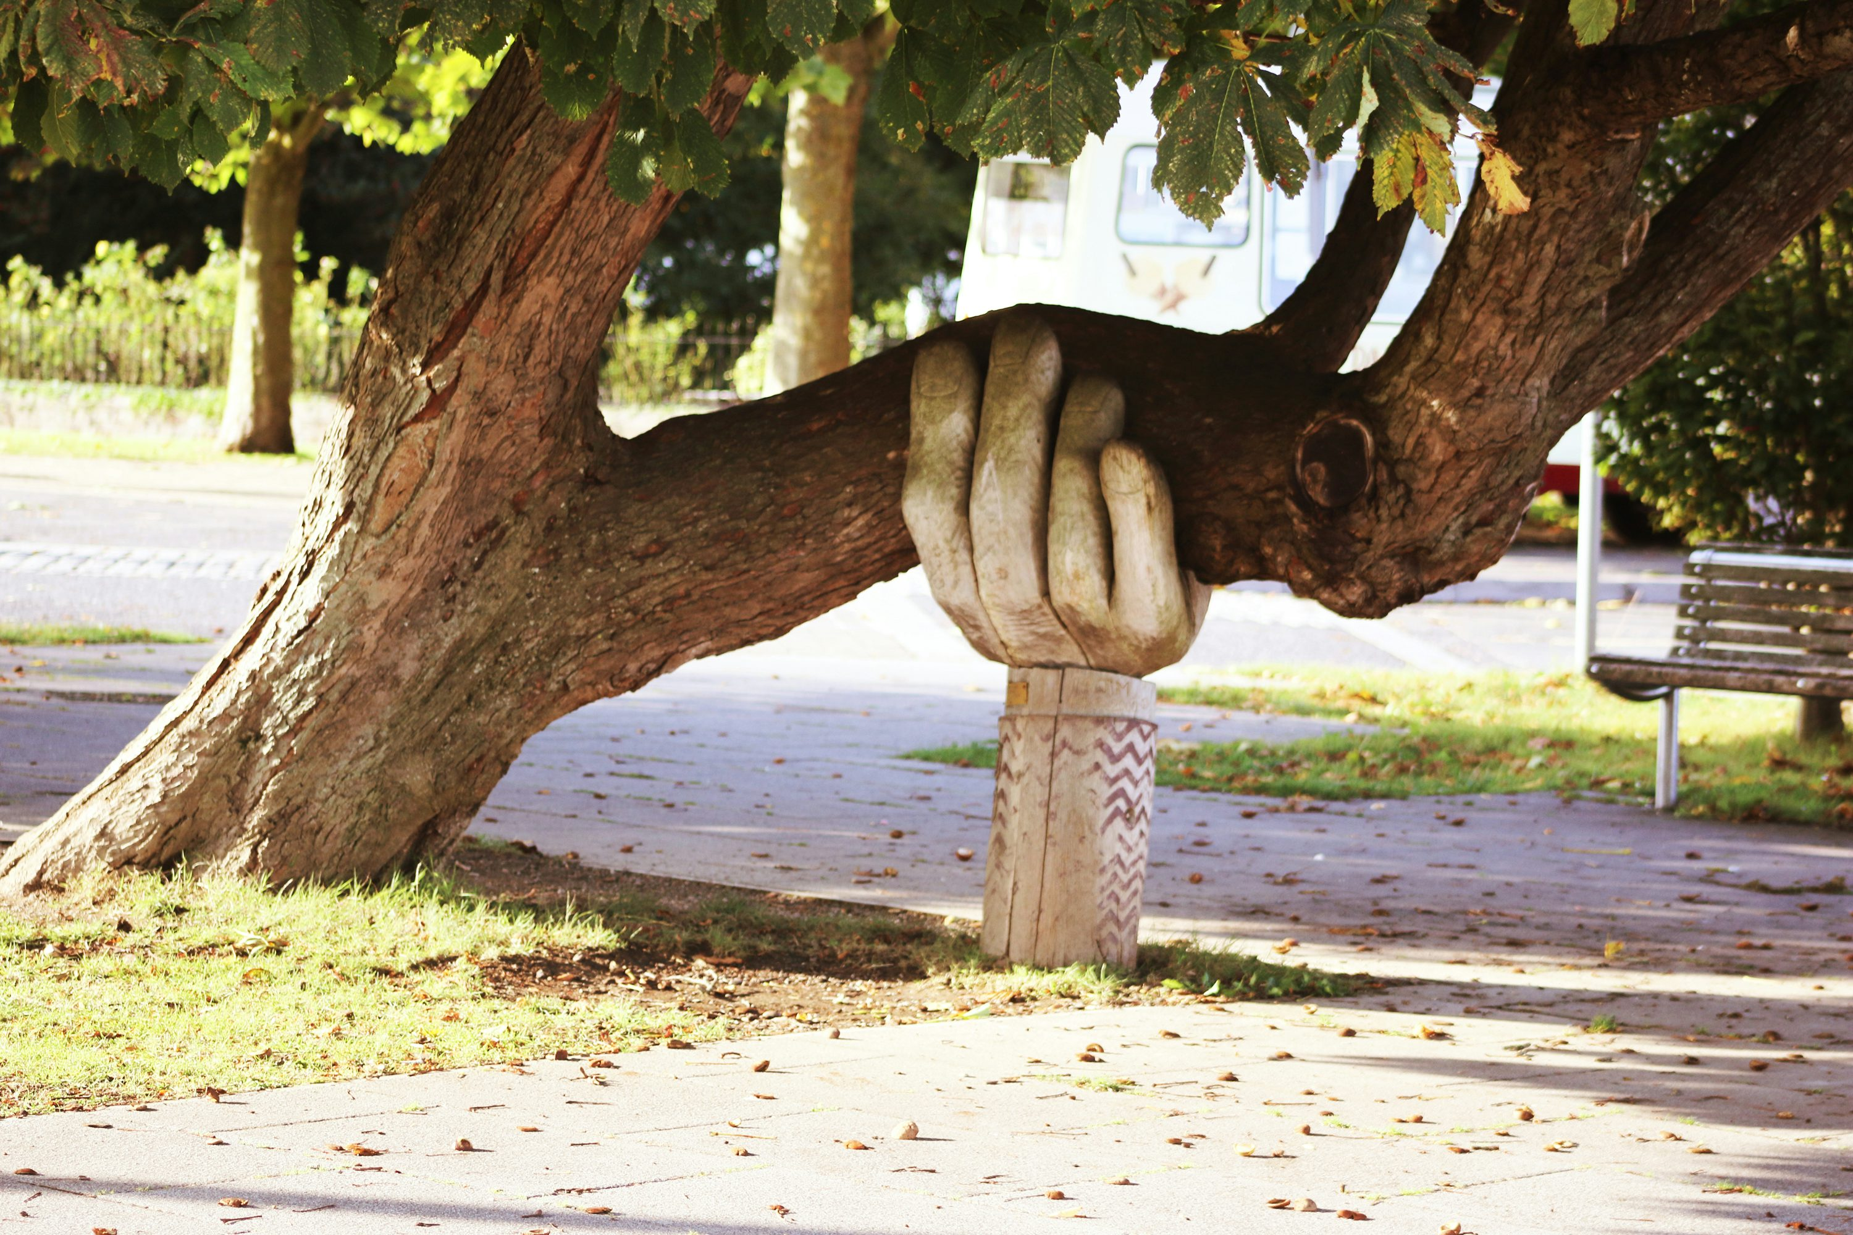

Slide 44
SUPPORTER final conference
Advancing Gender+ Equality in Widening Higher Education Institutions
Presentation: Students as changemakers
Iveta Bayerová, Charles University

Slide 45
How can students address gender-based violence?
Participation in official university bodies
Participation in student associations
Co-creating campus culture
on a daily basis

Slide 47
Instagram: @procjsmetonenahlasily.i

Slide 48
Instagram: @na.hlas

Slide 49
EGM 2024,
Kristýna Bělíková

Slide 52
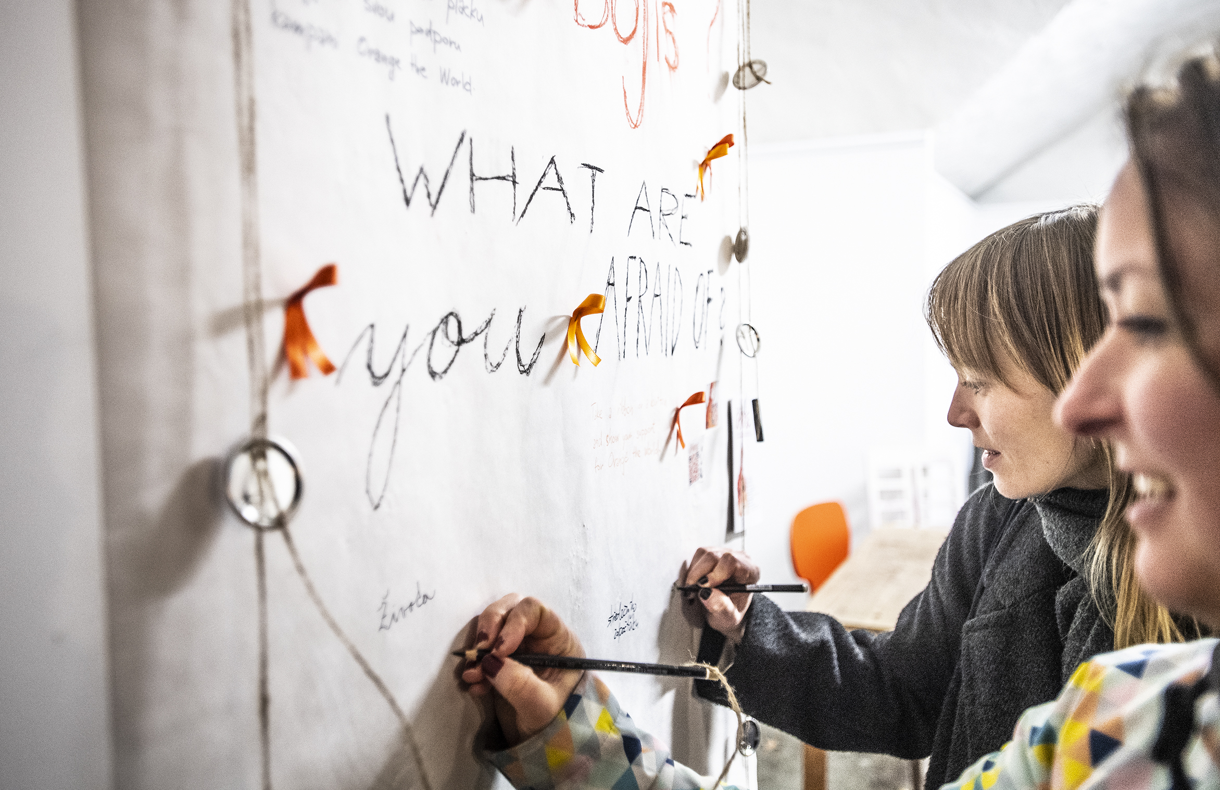

Slide 53
Conclusion

Slide 54
Thank you!
Iveta Bayerová
Equal Opportunities Agenda Coordinator CU Point
Ovocný trh 560/5 116 36 Praha 1
iveta.bayerova@ruk.cuni.cz +420 724 993 033 www.cuni.cz

Slide 55
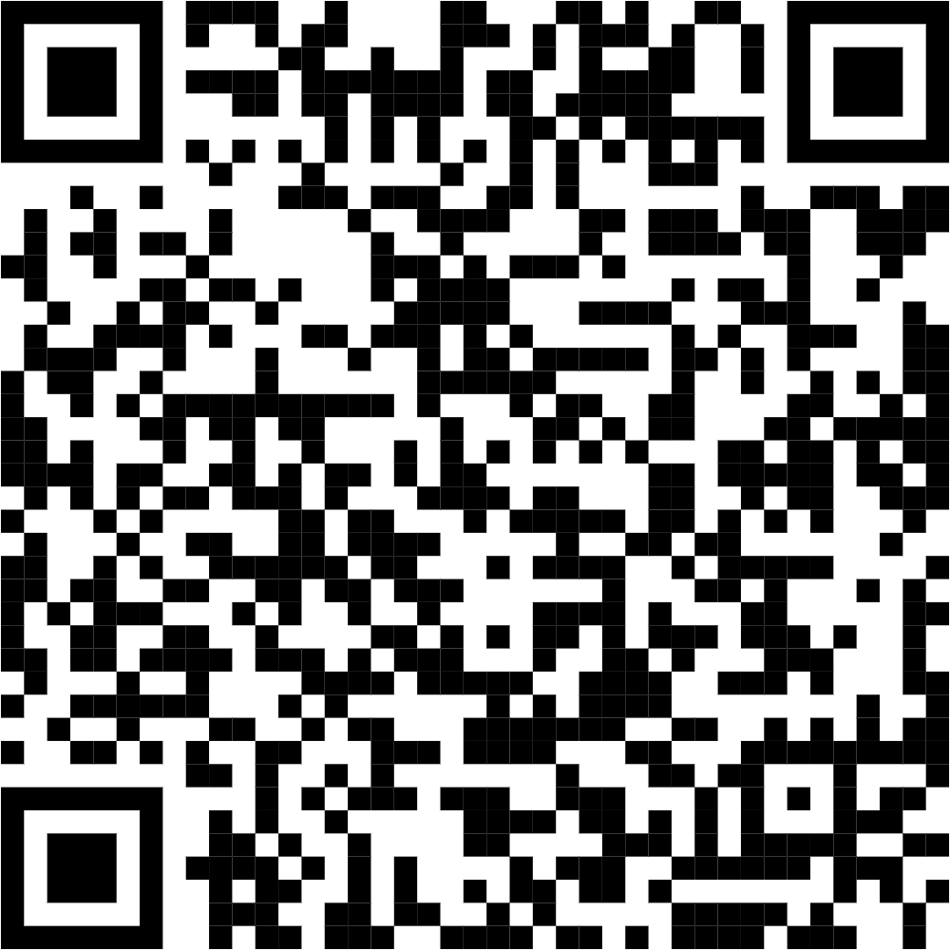
SUPPORTER final conference
Advancing Gender+ Equality in Widening Higher Education Institutions
SUPPORTER recommendations

Slide 56
Our platforms

